Slide 1


Evan Weiss
CHIEF EXECUTIVE OFFICER
June 9, 2026
Economic Development and Nuclear Energy in New Jersey

Slide 2





New Jersey’s Economic Momentum
NJ IS ADDING JOBS
NJ RANKED #1 IN NORTHEAST JOB CREATION SINCE JUNE 2020
NJ IS GROWING NEW SMALL BUSINESSES
NJ’S ECONOMY IS GROWING
NJ HOUSEHOLD INCOME IS GROWING
NJ HOMEOWNERSHIP IS ON THE RISE
1

Slide 3


The Authority's Strategic Priorities
Investing in Strong Communities
Invest in strong, resilient communities through strategic infrastructure, housing, innovation, and economic opportunity that drive inclusive growth across New Jersey.
Enhancing Agency Visibility Across Platforms
Increasing public awareness of NJEDA programs and services and deepening engagement with stakeholders to continuously improve on market offerings.
Expanding Education & Strengthening Workforce
Expanding access to high-quality education and strengthening workforce pathways through training and skills development that prepare New Jersey residents for in-demand jobs.
Advancing Affordability
Making New Jersey more affordable by expanding housing opportunity, lowering costs for working families, and fostering a more competitive and inclusive statewide economy.
Building a More Efficient and Responsive Government
Streamlining processes, improving transparency and accountability, and delivering more accessible, effective services for residents, communities, and businesses.
2

Slide 4
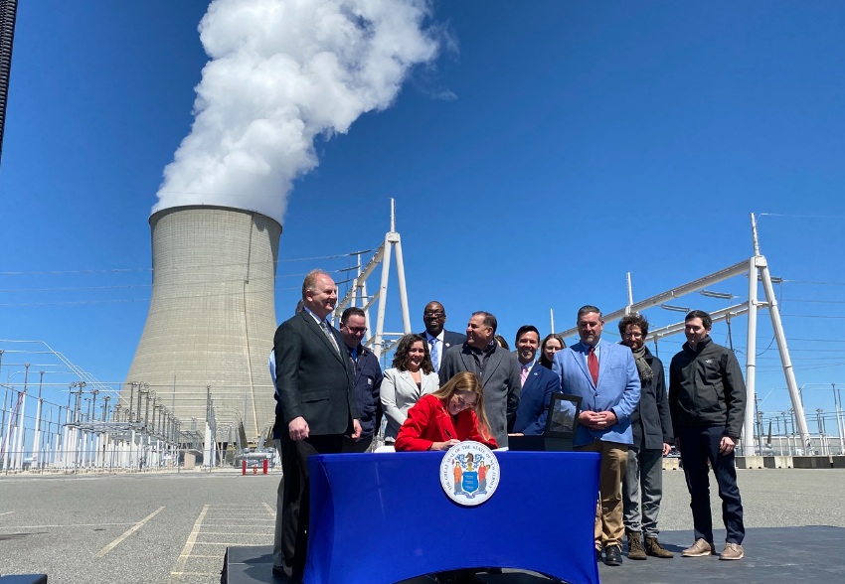
NJEDA and Nuclear Energy
Advancing Affordability
Listening to businesses, addressing rising energy demands
Strengthening the Grid
Partnering across state agencies to support storage, solar, and nuclear pathways
Supporting Innovation
Backing startups developing next‑generation technologies
3

Slide 5

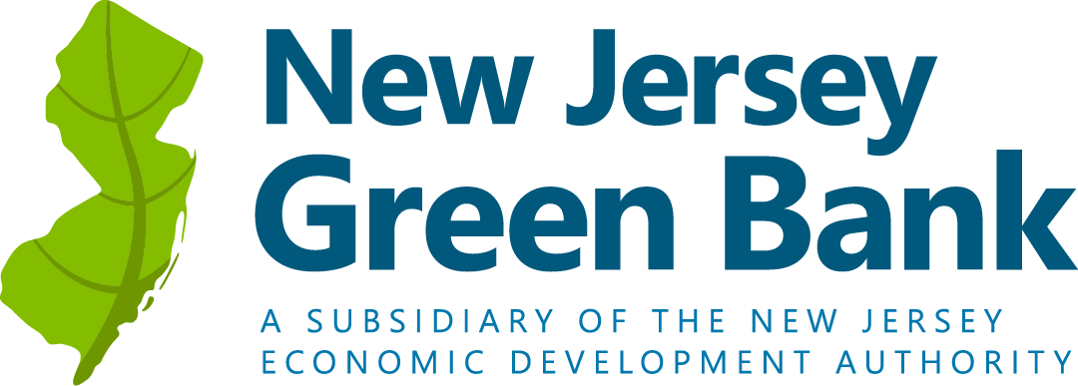

Programming Supporting Nuclear Investment
Working capital or project finance loans ($250K–$10M) for NJ‑based clean‑energy companies or projects.
Nuclear energy is included as one of the eligible clean‑energy technologies. Eligible financing can support SMR-related technologies.
Support for advanced‑technology manufacturers and supply‑chain firms.
Provides debt financing to attract private capital.
De-risks grid and site-readiness investments.
Opens nuclear-adjacent projects to institutional investors.
4

Slide 6

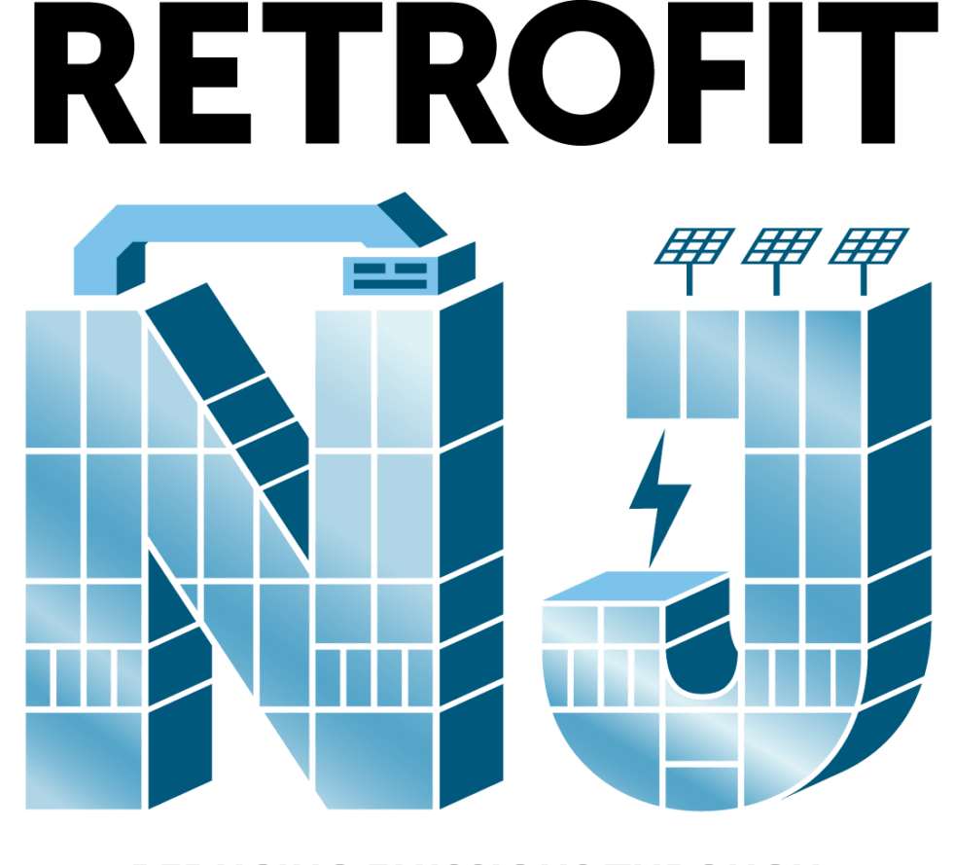

Grid Strengthening Programming
Financial assistance for retrofit projects that lower greenhouse‑gas emissions in overburdened communities.
Provides financing for commercial property owners to make energy‑ efficiency, renewable‑ energy, water‑saving, and resiliency upgrades.
Grant program for comprehensive building retrofits that improve energy performance and cut emissions.
5

Slide 7


Workforce Development for Grid Resilience
Green Workforce Training Grant Challenge (Phase 2)
$4M available for competitive grants building green economy talent pipeline focused on grid resilience, renewables, and efficiency
Clean Energy Fellowship Program
Designed to support interdisciplinary undergraduate and graduate student research on topics advancing clean energy concepts such as solar, wind, geothermal, green hydrogen, fuel cells, biomass, tidal, nuclear, and hydropower.
6

Slide 8




NJ HAX PLASMA FORGE
Opening in Q3 2026, the NJ HAX PLASMA FORGE is an innovation hub to accelerate commercialization of plasma technologies in clean energy, microelectronics, space propulsion, and quantum computing.
NJEDA INVESTMENT:
$24.5 million: $3 million fund
MAGNITUDE:
Will support 25 deep-tech startups over 5 years through incubation, acceleration, and investment
7

Slide 9

For More Information:
www.njeda.gov | @NewJerseyEDA

