Slide 1

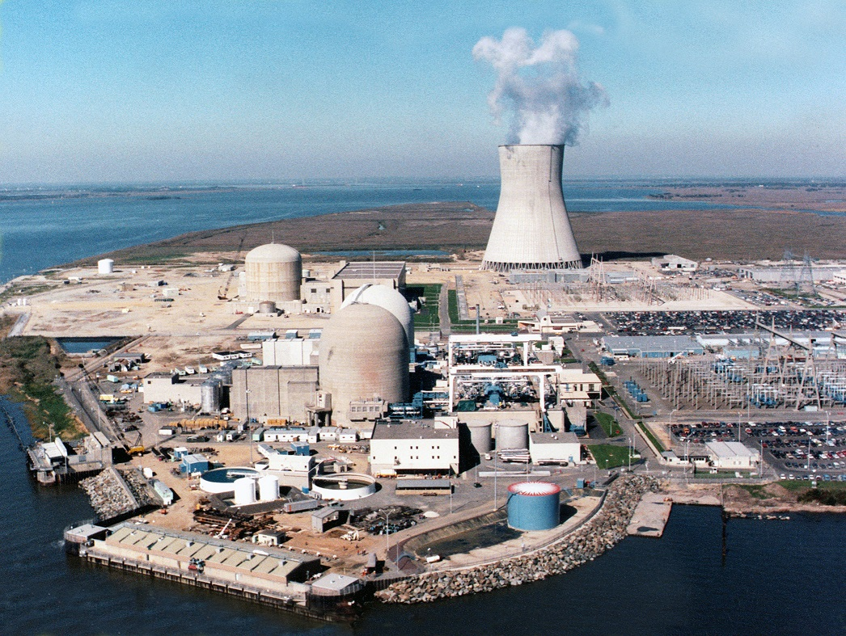
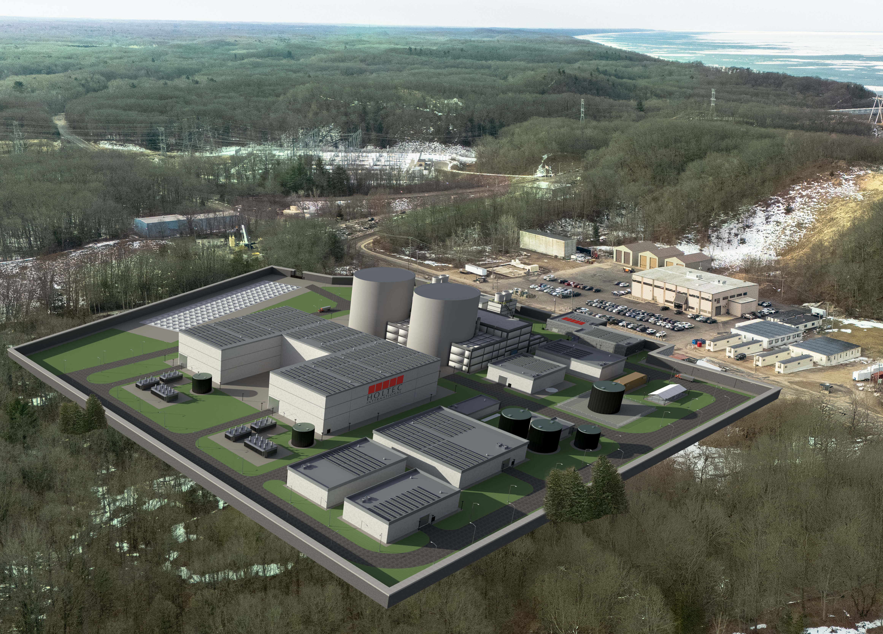
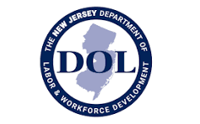
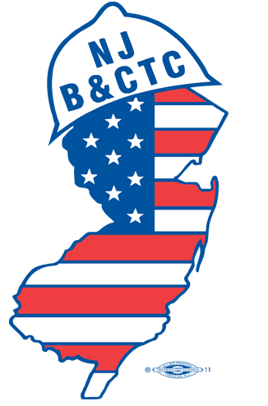



Meeting the Workforce Needs for Nuclear Expansion in New Jersey
Our Panel:
Howard Miller - Chief of Business Services, NJ Department of Labor & Workforce Development
Daniel Cosner - President, Southern New Jersey Building Trades and Construction Council
Joe Checkley - International Representative, IBEW
Yolanda Mack - Ph.D., Associate Dean for Industry Partnerships and Workforce Development, Rowan College of Engineering
Ken Robell - Vice President of Academic Affairs, Salem Community College
Marie Casanova
Director, Rowan Green Jobs Academy
Co-Director, ROWEC

Slide 2
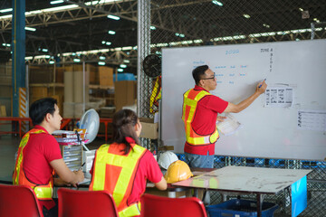


Building the Talent Pipeline for Expanded Nuclear
Complex infrastructure projects depend on a highly skilled workforce to achieve successful outcomes.
Collaborative Approaches & Initiatives
Industry
Business &
Utilities
Government –DOL, EDA, BPU, DEP +
Workforce Development Boards
Educational Institutions/ Universities
Trade & Professional Associations
Labor
Community Colleges &Trainers
Industry and Market Driven Curriculum
Experiential Learning & Hands-On Training
Industry-Engaged Projects & Internships
Industry-Valued Credentials & Certificates
Professional Development & Upskilling
Nuclear Career Awareness & Promotions
Flexible Career Pathways
Public & Community Awareness & Confidence

Slide 3
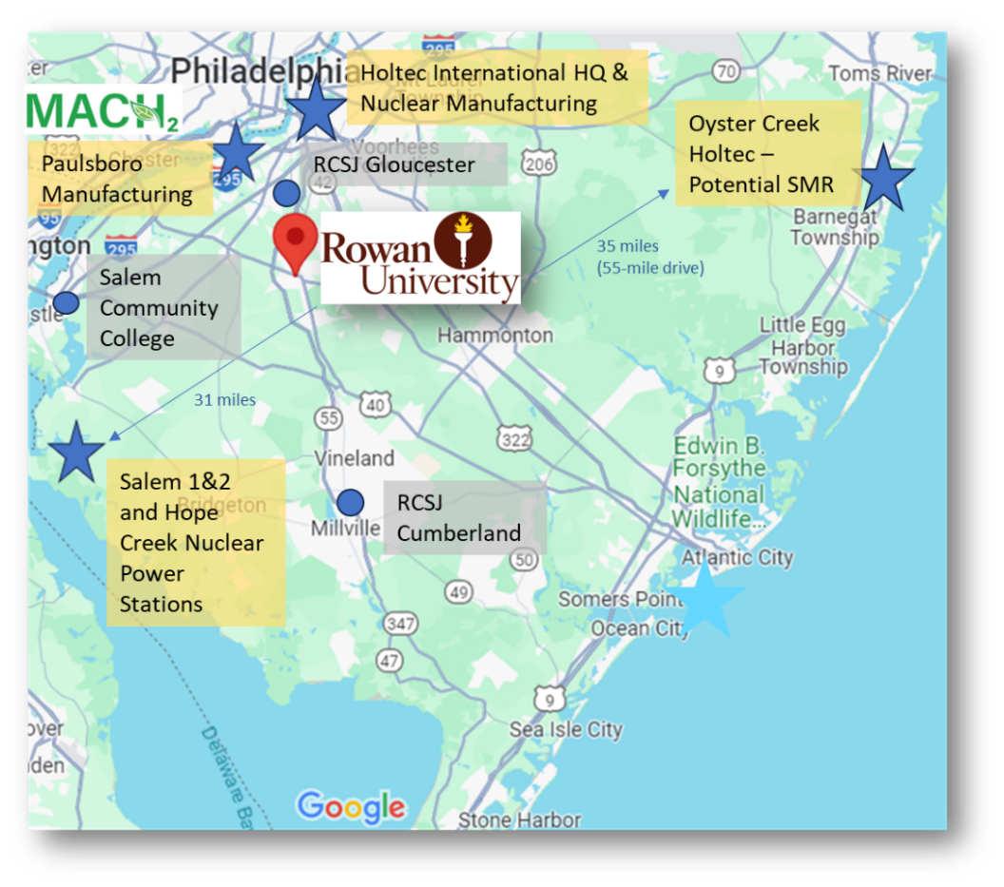
Location, Location, Location
Rowan University is the only New Jersey university located within a 35-mile radius of the state’s critical nuclear assets and nuclear manufacturing hub, including:
New Jersey’s only operating nuclear stations - Salem 1 & 2 and Hope Creek – PSEG Nuclear
Holtec International’s Headquarters and Advanced Nuclear Manufacturing Facility
Holtec’s Oyster Creek decommissioned nuclear facility, potential site of the first New Jersey SMR

Slide 4
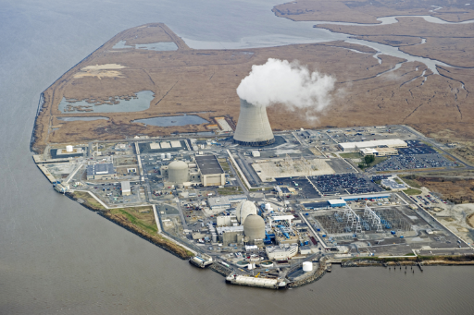
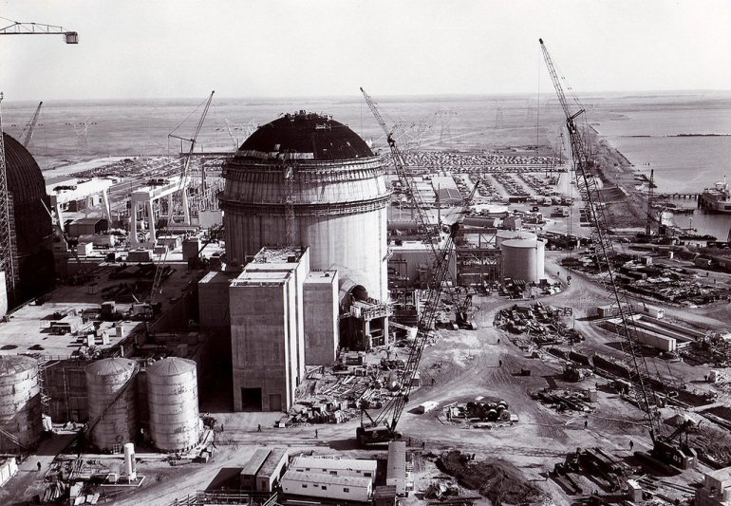
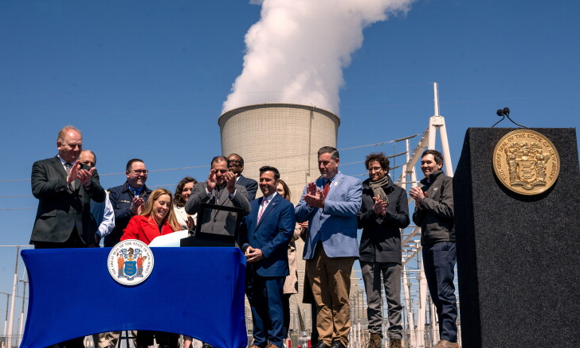
Salem Unit 1 & 2
Hope Creek
Salem Unit 1 under construction
Almost 58 years later

