Slide 1


PSEG Nuclear:
Rowan University Sweeney Center for Public Policy
June 9^{th,} 2026

Slide 2
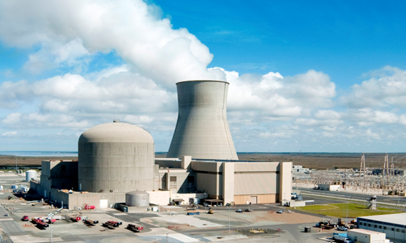
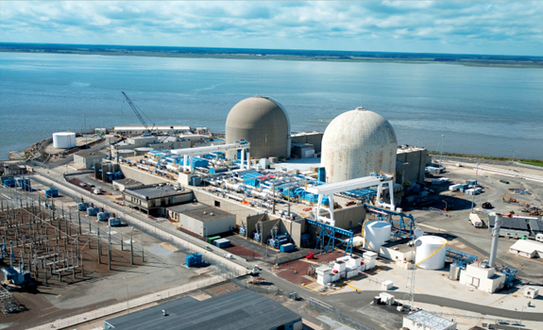
Salem and Hope Creek Nuclear Plants
PSEG Nuclear Overview
4th largest site in the United States
  Approximately 3,575 MW that produces enough electricity to power 2.7 million homes
Each unit licensed for 60 years — license renewal completed
  Salem Unit 1 (PWR, 1180 MW) — Licensed 1976; renewed license expires 2036
  Salem Unit 2 (PWR, 1175 MW) — Licensed 1981; renewed license expires 2040
  Hope Creek (BWR, 1219 MW) — Licensed 1986; renewed license expires 2046
Maintenance and Refueling Outage:
  A planned maintenance and refueling outage is a scheduled interruption in power production to swap out old fuel for new and to perform maintenance that cannot be done while the plan is operating, which supports reliability and local job creation.
Notes:
Presenter: Chaz

Slide 3
PSEG Nuclear Overview
Nuclear Critical to Affordable Power
Nuclear is a unique asset class providing reliable 24x7, carbon-free energy
and price stabilization
PSEG Nuclear is important to New Jersey’s economy
  Supports an annual payroll of more than $250 million
  Purchases more than $60 million a year in New Jersey goods and services
  Contributes $1.2 billion annually on net in Salem County and $57 million in surrounding
  New Jersey counties
PSEG Nuclear is a leading employer in Salem County and Southern NJ
  4,530 in-state direct and secondary jobs, including 3,990 jobs in Salem County
  1,639 full-time employees — 70% of employees live in South Jersey
  (36% in Salem County and 34% in Gloucester, Cumberland and Camden counties)
  1,000 additional contractors twice per year to support maintenance and refueling outages
PSEG Nuclear provides ~40% of New Jersey’s energy capacity and ~80% of New Jersey’s clean energy capacity
NJ Electric Generation
by Fuel Source 2022*
2020 Brattle Report: https://www.brattle.com/wp-content/uploads/2021/05/20628_salem_and_hope_creek_nuclear_power_plants_contribution_to_the_new_jersey_and_local_economies.pdf
Notes:
Presenter: Chaz

Slide 4
PSEG Nuclear — Key Fleet Data
PSEG Investor Update May 2026
Fleet Average Capacity Factor of 95.5% for First Quarter 2026
57% PSEG ownership
658 MW owned capacity
Current license expires 2036
18-month operating cycle
Next refueling scheduled Fall 2026
50% PSEG ownership
632 MW owned capacity
Current license expires 2053
24-month operating cycle
Next refueling scheduled Fall 2026
Hope Creek
BWR
NJ
Salem Unit 2
PWR
NJ
Peach
Bottom Unit 3
BWR
PA
Salem Unit 1
PWR
NJ
Peach
Bottom Unit 2
BWR
PA
100% PSEG ownership
1,174 MW owned capacity
Current license expires 2046
24-month operating cycle
Next refueling scheduled Fall 2027
57% PSEG ownership
651 MW owned capacity
Current license expires 2040
18-month operating cycle
Next refueling scheduled Fall 2027
50% PSEG ownership
643 MW owned capacity
Current license expires 2054
24-month operating cycle
Next refueling scheduled Fall 2027
Notes:
Presenter: Chaz

Slide 5
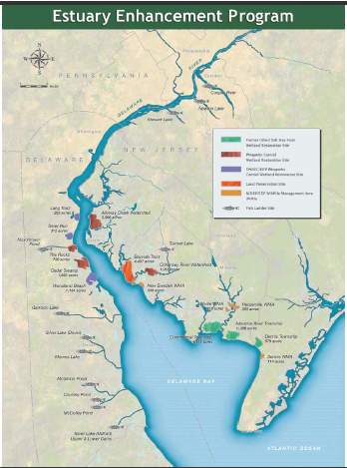
Nuclear Growth and Plant Reliability Projects - Total Generation Increase of Approximately 5%
  Salem Power Uprate
    Investment over 6 years to include capital upgrades on secondary plant equipment
    Increases Salem power production by approximately 160 MW of clean 24/7 energy by 2029
  Salem and Hope Creek Subsequent License Renewals
    Extend operating licenses by 20 years to 2056 for Salem 1, 2060 for Salem 2. 2066 for Hope Creek
    Communicated to NRC in 2025, license request submittal - 2027, NRC approval - 2029
    Hope Creek 24-Month Operating Cycles & Cooling Tower Upgrade
    Extending operating cycle (18 to 24 mos.) eliminates 6 refueling outages over extended plant life
    Cooling Tower upgrade improves output by 12 MW
  Salem Moisture Separator-Reheater and Salem 2 Turbine Retrofits
    Improves plant reliability and efficiency for the long term
    Raising power production by 30 MW
ttps://www.brattle.com/wp-content/uploads/2021/05/20628_salem_and_hope_creek_nuclear_power_plants_contribution_to_the_new_jersey_and_local_economies.pdf
Notes:
Presenter: Chaz

Slide 6
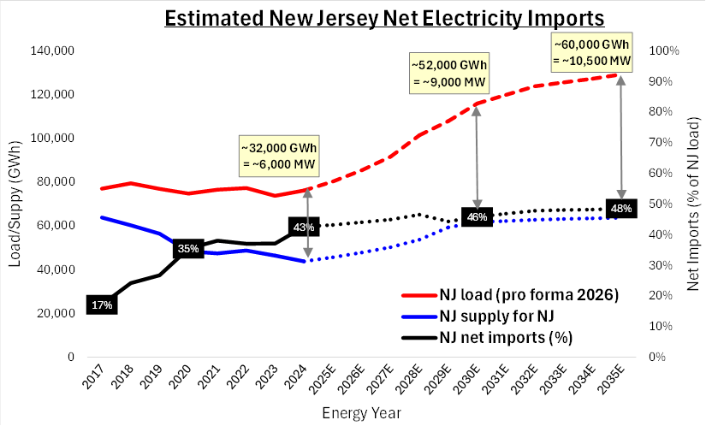
NJ's gap of energy needs and in-state supply continues to grow
Key Assumptions
  Solar & Storage – NJ achieves 100% of policy goal of 12GW Solar and 2 GW storage by 2030
  Large load – includes recent additions above PJM’s prior 2025 forecast
  Other – assumes Nuclear and Gas uprates, higher utilization of existing gas units, and retirements of certain gas units under PACT rules
Data sources: PJM for state load and interface data (NJ exports via cable); EIA and S&P Global for NJ generation; PSEG analysis

Slide 7
New Nuclear Opportunity at Salem
PSEG holds an Early Site Permit (ESP) for new nuclear
  Only 1 of 6 granted in the U.S. – the first step in licensing a new nuclear plant and provides the environmental and site-specific authorizations for plant construction
Adjacency to existing nuclear lowers construction, operation, and licensing costs
  Shared services such as Operations, Maintenance, Training, Security, Spent Fuel Storage, Fire/Medical all reduce the required costs to build and operate new nuclear
  Existing fleet has over 40 years of operational data at the site, which de-risks NRC review
Location provides excellent means of component shipment to site
  The deep water port provides opportunity to have large modules shipped directly to site via ship
  The adjacency to the port could reduce construction time and costs.
Notes:
Presenter: Milo

Slide 8
Thank

Slide 9
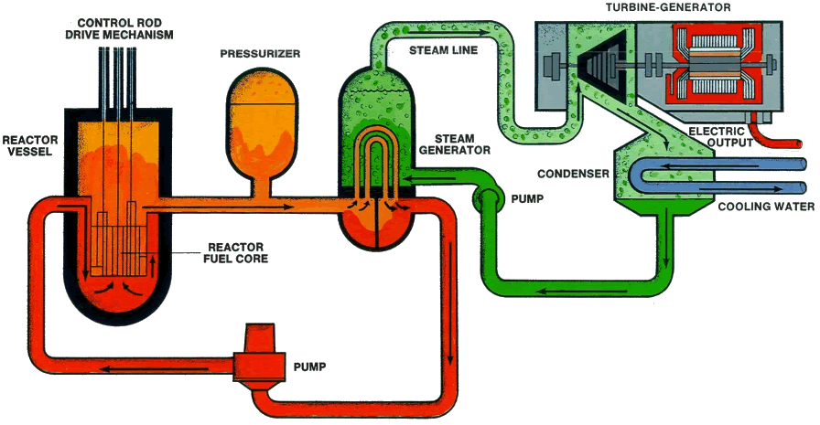
Salem 1 & 2 —
Pressurized Water Reactors
PSEG Nuclear Overview
Notes:
Chaz

Slide 10
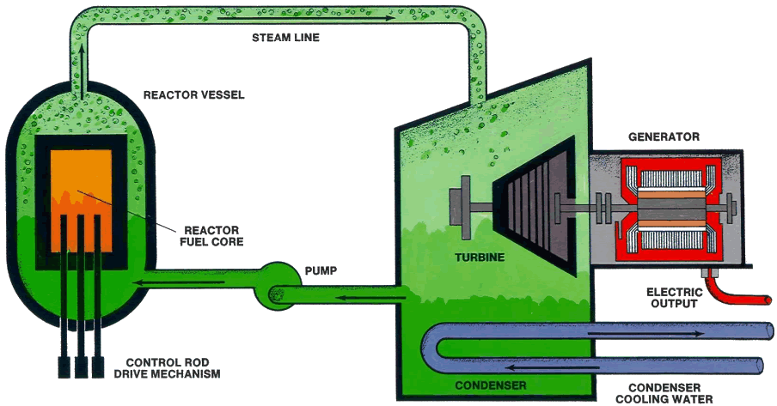
Hope Creek —
Boiling Water Reactor
PSEG Nuclear Overview
Notes:
CHAZ

