Slide 1
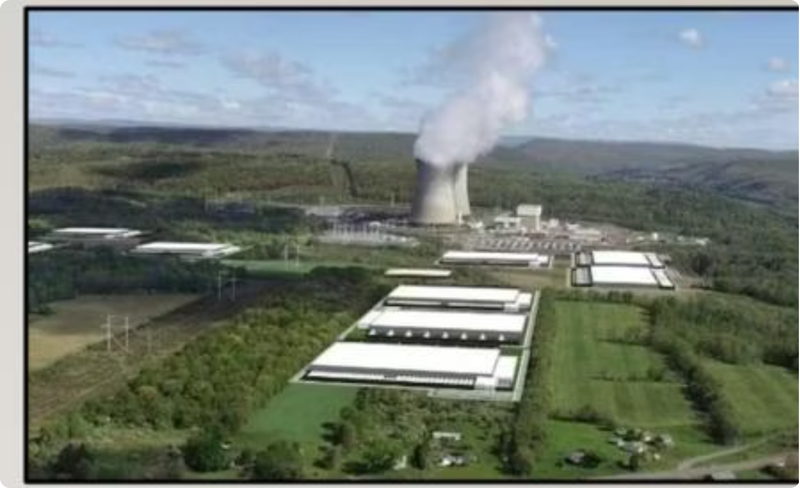

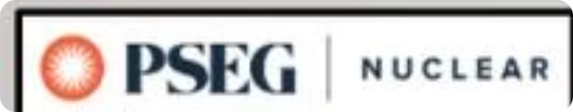
Nuclear Energy Technology (NET) Program
A high-quality, student-focused, and low-cost pathway to a career in nuclear energy
Ken Robell, Vice President of Academic Affairs, Salem Community College

Slide 2
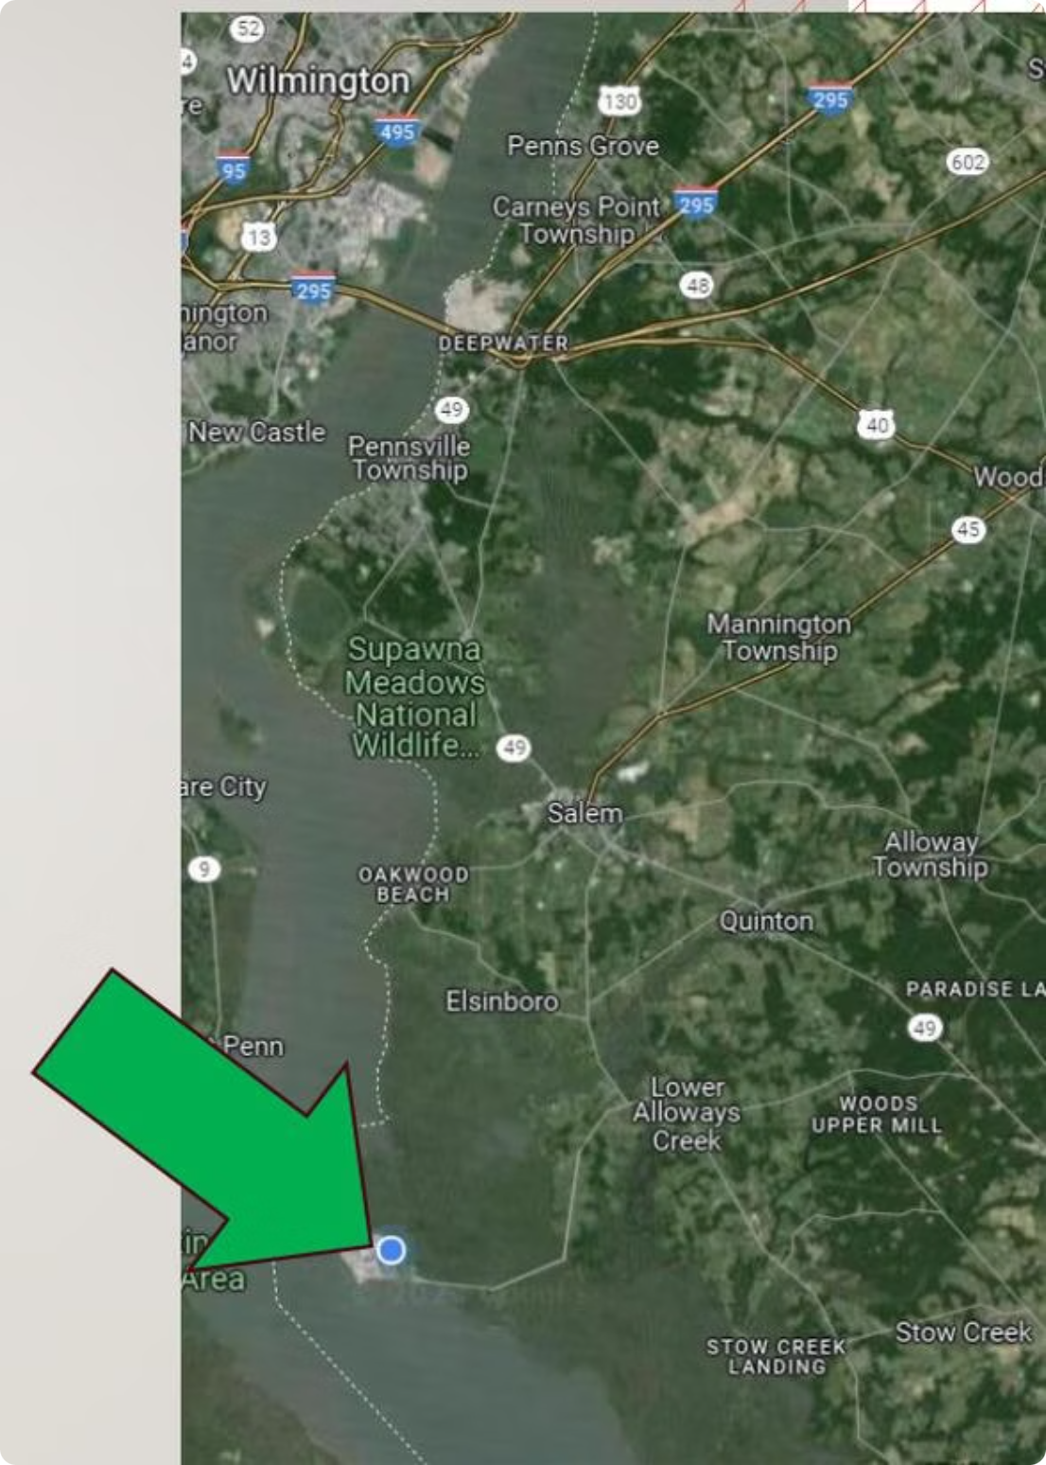
PSEG Nuclear — Hope Creek & Salem Stations
Located in Lower Alloways Creek Township, the Hope Creek and Salem stations represent the fourth-largest nuclear site in the country.
3,575 MW
Total Capacity
Enough electricity for 2.7 million homes.
40%
NJ Electric Generation
Largest single source of electricity in New Jersey.

Slide 3
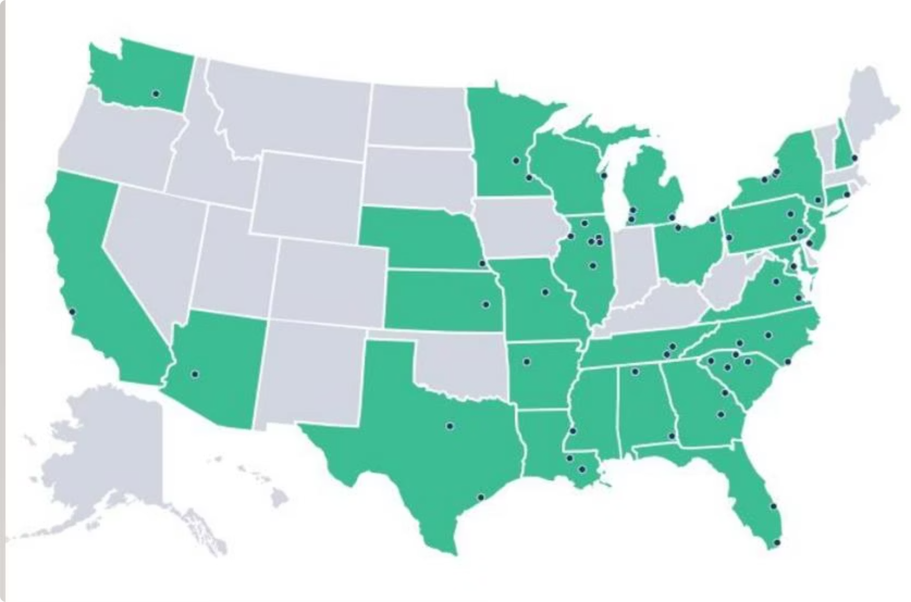
Nuclear — It's In Demand
The US Department of Energy's Pathways to Commercial Liftoff: Advanced Nuclear report estimates that achieving US decarbonization targets by 2050 will require 200GW of nuclear power at 13GW of new capacity per year — demanding 375,000 nuclear industry workers, a 275% increase from today's ~100,000.
Restarting Closed Plants
License Extensions
Power Upgrades
New Builds

Slide 4

Two Pathways Into Nuclear
Associate’s Degree — Nuclear Energy Technology
Bachelor's Degree — Engineering
2 years to completion
Prepares for hands-on technical roles
Adjunct faculty with application-focused approach
Lower cost
Schedule allows more time for study/work
4 years to completion
Prepares for specific Engineering roles
Academically-oriented professors, some researchers
Typically a more holistic education

Slide 5
SCC Nuclear Energy Technology Program
Associate in Applied Science
First Year
NET 111 Mathematics for Energy Technicians
NET 115 Mechanical Sciences
NET 130 Applied Physics and Chemistry
NET 131 Nuclear Industry Fundamental Concepts
NET 133 Electrical Science
Second Year
NET 211 Heat Transfer and Fluid Flow
NET 213/225 Instrumentation and Control I & II
NET 221 Nuclear Science
NET 223 Reactor Plant Protection and Safety
NET 251 Maintenance: Electrical Systems
NET 261/263 Nuclear Plant Systems & Components – PWR/BWR

Slide 6
SCC vs. University: Program Comparison
Feature
Typical University Nuclear Engineering
SCC Nuclear Energy Technology
Accredited Associate degree
Degree
Accredited Bachelor degree
Location
Regional campus → main campus
Evening classes in Salem, NJ; some in HS
Adjunct staff from PSEG Nuclear Training
Faculty
Reputable nuclear engineering faculty
Summer internship at PSEG Nuclear ($23/hr)
Internship
Available; location & pay vary
Scholarships
Availability varies
PSEG-sponsored; available to virtually all students in good standing

Slide 7
Nuclear Career Compensation
Nuclear energy careers offer highly competitive salaries across
a range of technical and engineering roles.
Equipment Operator
Maintenance Technician
$73,000 – $121,000
$63,000 – $90,000
Reactor Operator
Senior Reactor Operator
Reactor Engineer
$129,000 – $134,000
$120,000 – $190,000
$75,000 – $165,000

Slide 8
The Cost Difference Is Dramatic
SCC's Nuclear Energy Technology program delivers a career-ready credential
at a fraction of the cost of a traditional university degree.
SCC Nuclear Energy Technology
Typical University Nuclear Engineering
Semester 1: $5,800
Semester 2: $6,200 ($3,100 w/ scholarship)
Semester 3: $6,000 ($0 w/ scholarship)
Semester 4: $6,400 ($0 w/ scholarship)
Semesters 1–4: $15,000 each
Semesters 5–8: $18,000 each
Includes housing & fees, excludes meals
Total: $24,400 ($8,900 after benefits/transfers)
Total: $132,000

Slide 9
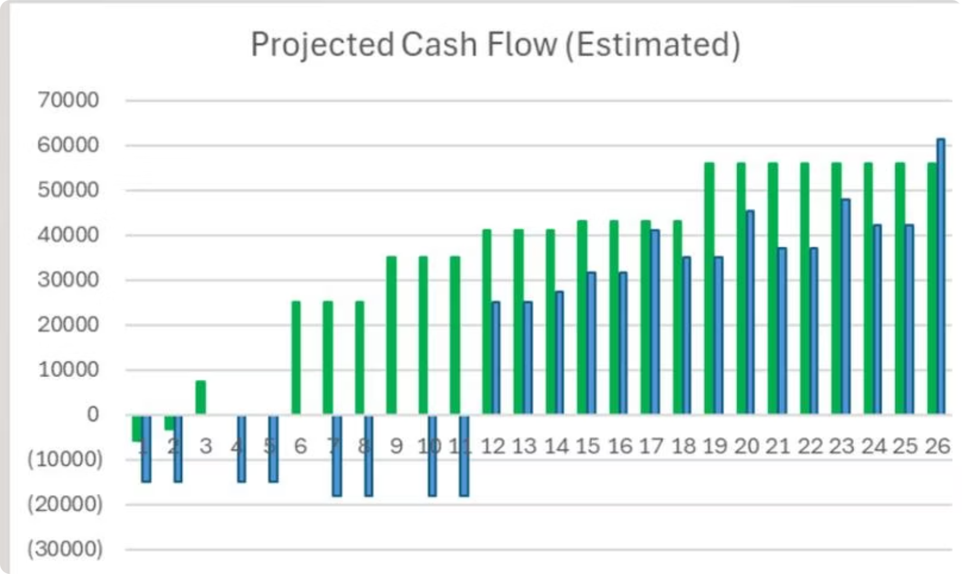
Cash Flow Projections (8 Years)
The projected cash flow comparison over 8 years illustrates the financial advantage of the SCC pathway versus a traditional university degree.
$921K
SCC NET Path
Estimated 26-year cumulative cash flow (green series).
$434K
University Path
Estimated 26-year cumulative cash flow (blue series).
The SCC pathway generates earnings sooner, with lower upfront costs and faster entry into the workforce — resulting in significantly higher lifetime cumulative cash flow.

Slide 10
SCC NET & PSEG Partnership
The SCC NET program is a high-quality, student-focused, and low-cost pathway to a career at PSEG Nuclear. The partnership is built around three ambitious goals:
Enrollment Target
Certification Rate
Hiring Rate
More than 20 students enrolled in the SCC NET program by fall 2027.
Program certification rate greater than 95% for all enrolled students.
SCC NET-to-PSEG hiring rate greater than 80% for program graduates.

Slide 11
SCC NET & PSEG PARTNERSHIP
Nuclear Regulatory Commission (NRC)
Institute for Nuclear Power Operations (INPO) – accreditation of training programs
Nuclear Uniform Curriculum Program (NUCP) – portability, efficiency, accredited
PSEG/SCC Nuclear Energy Tech – Operators, Maintenance Techs, RP/Chem Techs
Adjunct Professors, Resources, and Financial Sponsorship

Slide 12
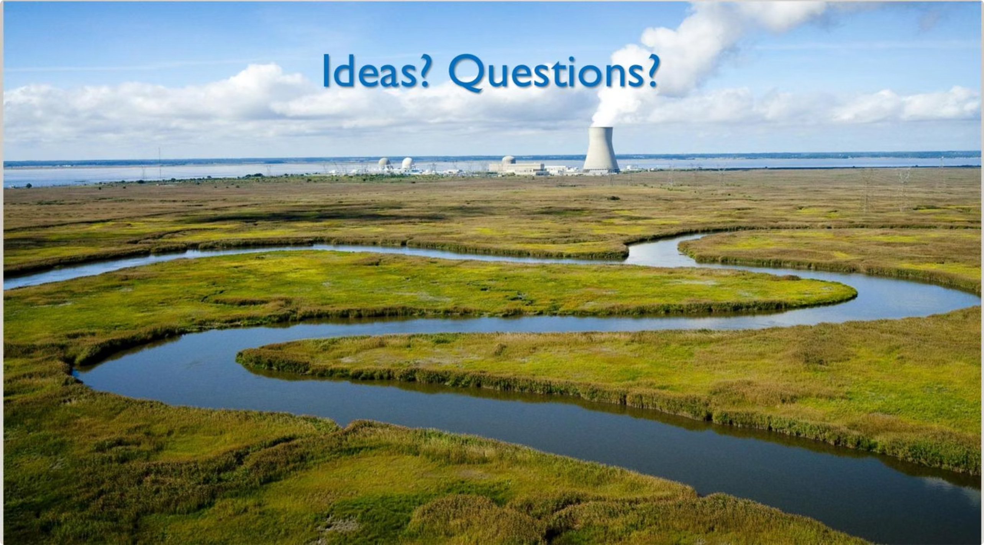


The SCC Nuclear Energy Technology program offers a proven, affordable, and direct pathway to a rewarding career at PSEG Nuclear — powering New Jersey and the nation's clean energy future.

