Slide 1


Why Nuclear?: System Role, Costs, Safety, and Perception
Victor Ibarra, Senior Manager for the Advanced Nuclear Energy Program, Clean Air Task Force
June 9th , 2026
Confidential & Not for Distribution

Slide 2
Nuclear has become popular again
Private industry is procuring new (and reviving old) nuclear in the US:
  Google has procured 500 MW of advanced nuclear from Kairos Power.
  Dow Chemicals and X-Energy signed a joint development agreement for four Xe-100 units.
  Amazon funded Cascade Advanced Energy Facility in Washington plans for 12 X-Energy reactors.
  Microsoft signed a deal to revive 835 MW Three Mile Island nuclear power plant.
  NRC authorized Palisades (800 MW) to restart.
In New York State, Gov. Hochul has directed the New York Power Authority (NYPA) to develop and construct no less than 1 GW advanced nuclear power in Upstate New York.
Illinois executive order by Gov. Pritzker will support the deployment of new nuclear facilities with a goal of "delivering at least two gigawatts of new clean nuclear capacity."
“Tennessee Valley Authority Tennessee signed agreement for 6 GW of new nuclear.
In 2025, the U.S. government announced an $80 billion partnership with Westinghouse Electric Company, Brookfield Asset Management, and Cameco Corporation to deploy a new fleet of AP1000 nuclear reactors
Globally, over 60 reactors are under construction.
Confidential & Not for Distribution

Slide 3
What Role Might Nuclear Play for Decarbonization?
Before we dive in, it should be emphasized that there is a need to massively expand renewables, transmission, and storage under all futures with and without nuclear…
But there are three perspectives we should consider for assessing the role of nuclear:
Clean supply optionality
Lessening the infrastructure buildout challenge to achieve decarbonization
Lowering the system cost of decarbonization
Confidential & Not for Distribution

Slide 4
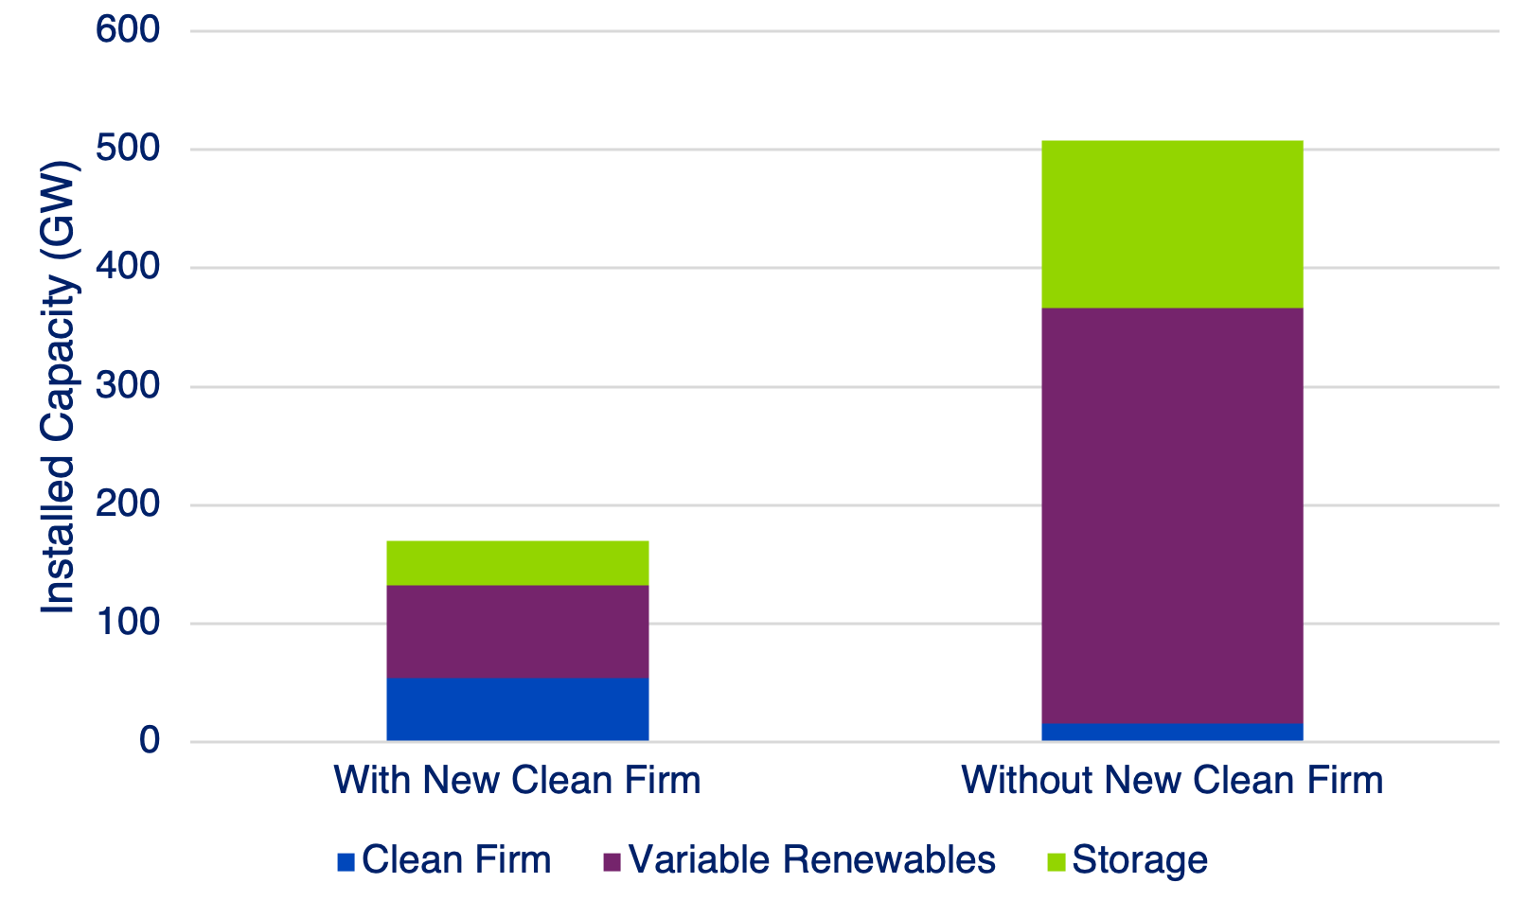
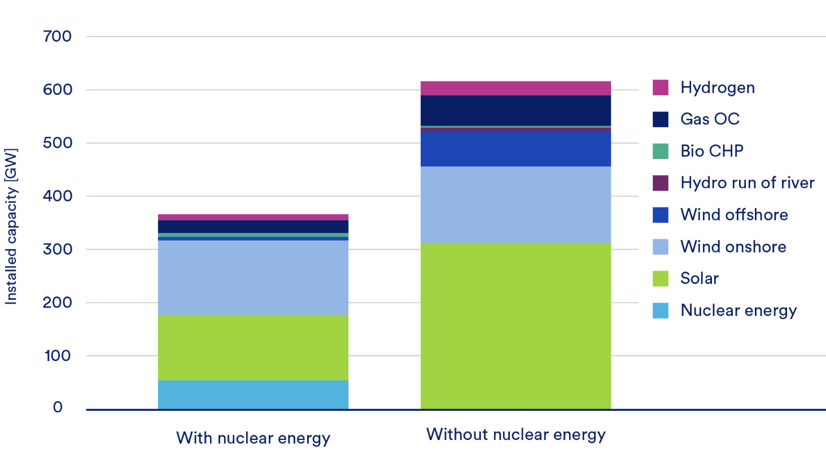
Clean Firm Reduces Enormous Buildout Needed to Decarbonize
California Decarbonization – 2050 Results
Germany Decarbonization – 2050 Results
~250 GW
~300 GW
Source: Long et al. (2021). Clean firm power is the key to California’s carbon-free energy future. Issues in Science and Technology. https://issues.org/california-decarbonizing-power-wind-solar-nuclear-gas/
Source: Quantified Carbon. (2025). Clean Firm Power in Europe’s Energy Transition. https://cdn.prod.website-files.com/650ac0ab00dff792a8cebc3c/6978eef2e54578d3f5da976f_CATF_4%20Report.pdf
Confidential & Not for Distribution

Slide 5
Cost Savings More than Clean Firm Cost
Diff. in Annual Investment between Scenarios ($B/yr)
Diff. in Total Costs between Scenarios ($B/yr)
More costs in
E+RE- Scenario
More costs in E+RE- Scenario
CO₂ T&S
CCS
Nuclear
More costs in
E+RE+ Scenario
More costs in
E+RE+ Scenario
RE+Storage
T&D
Bio
H2
Notes: Investment costs differences in Princeton’s Net Zero America between the E+RE- and E+RE+ scenarios, showing how additional nuclear and CCS investment can offset a disproportional amount of renewable, transmission, and H₂ cost.
Confidential & Not for Distribution

Slide 6
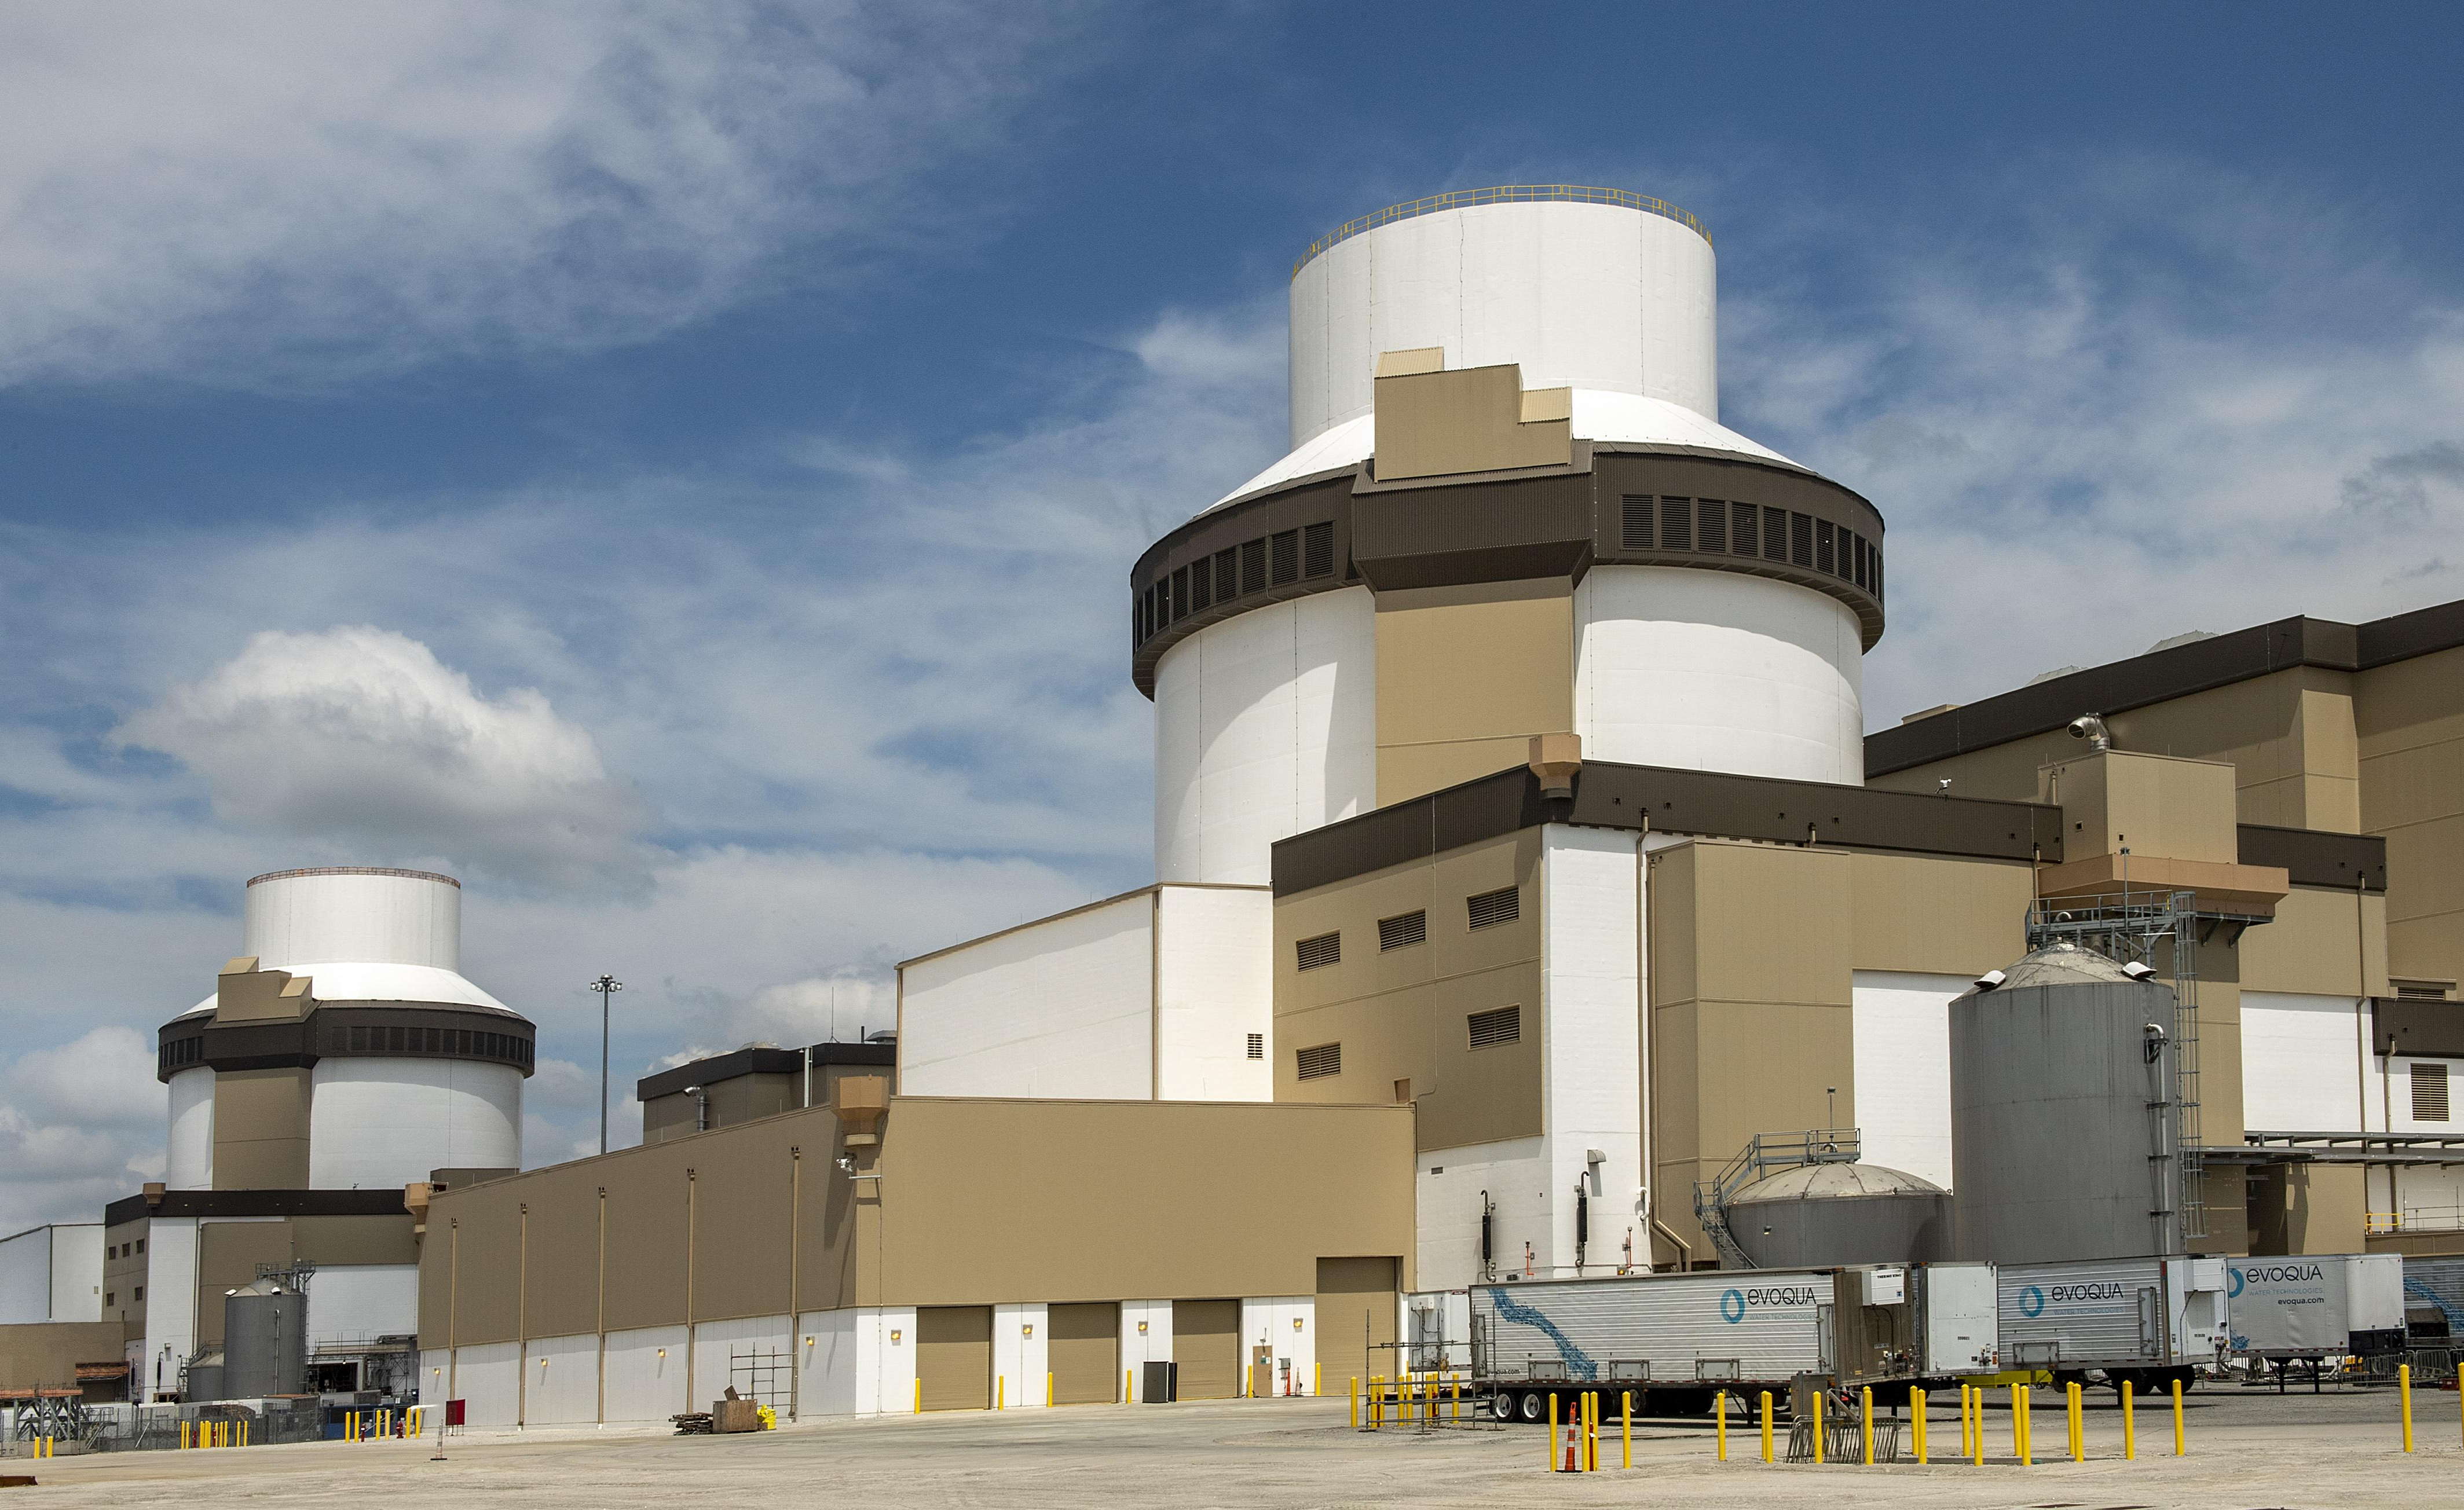
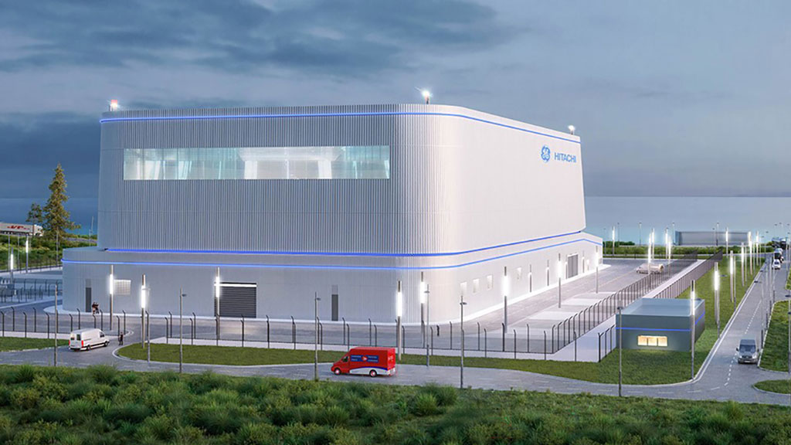
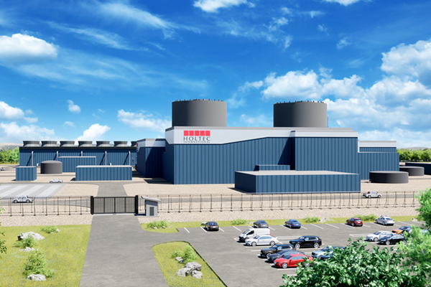
Large and small light water reactors enable near-term deployment of larger new nuclear reactors
Westinghouse AP1000
2 reactors operational at Vogtle 3&4
2 reactors announced for completion at V.C. Summer in South Carolina
4 reactors announced at Fermi America and Project Matador in Texas
$80B of new AP1000s under discussion
GEH BWXR-300
Targeted deployment of first reactor by 2028 at Darlington, Canada site
Up to 4 units deployed by OPG
Additional units may be built in
U.S. by TVA, Duke, and Dominion
Holtec SMR-300
Targeted deployment of two reactors by 2030 at Palisades site
Additional units may be deployed in United Kingdom or Canada
Confidential & Not for Distribution

Slide 7
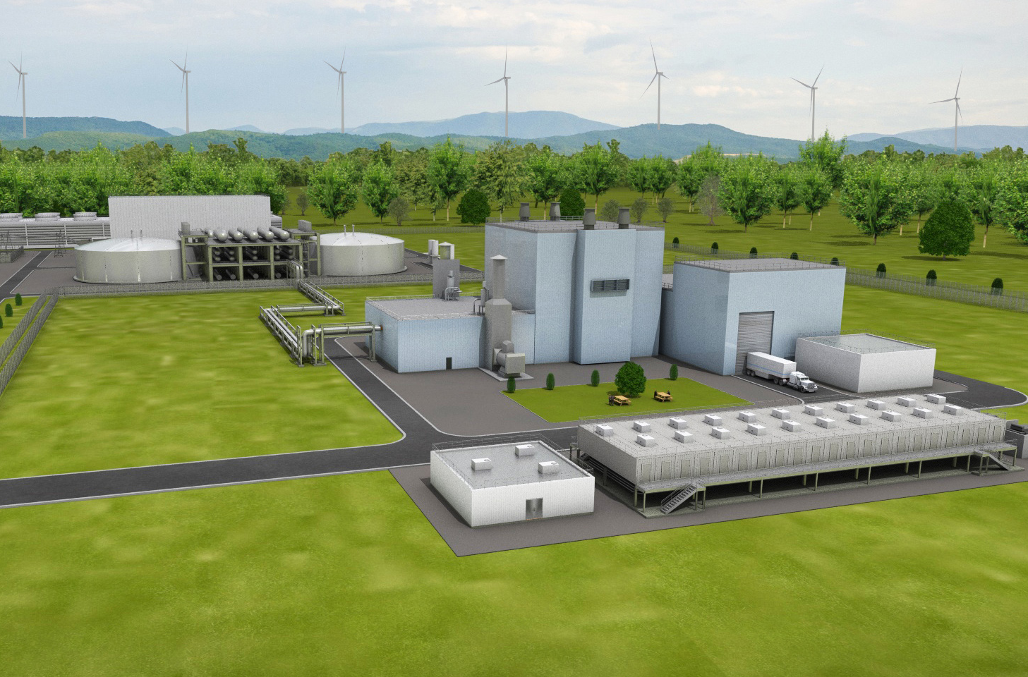
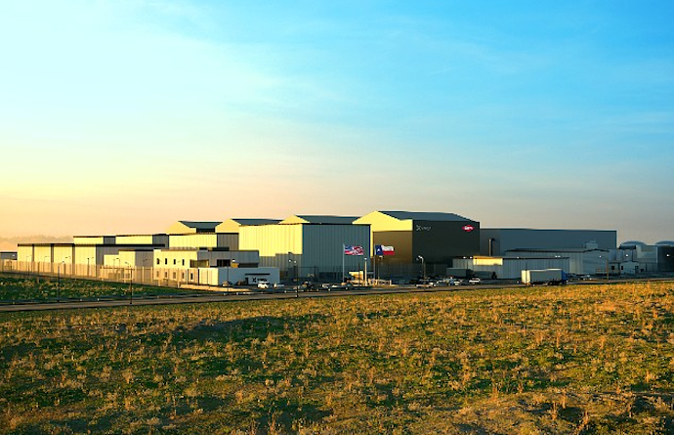
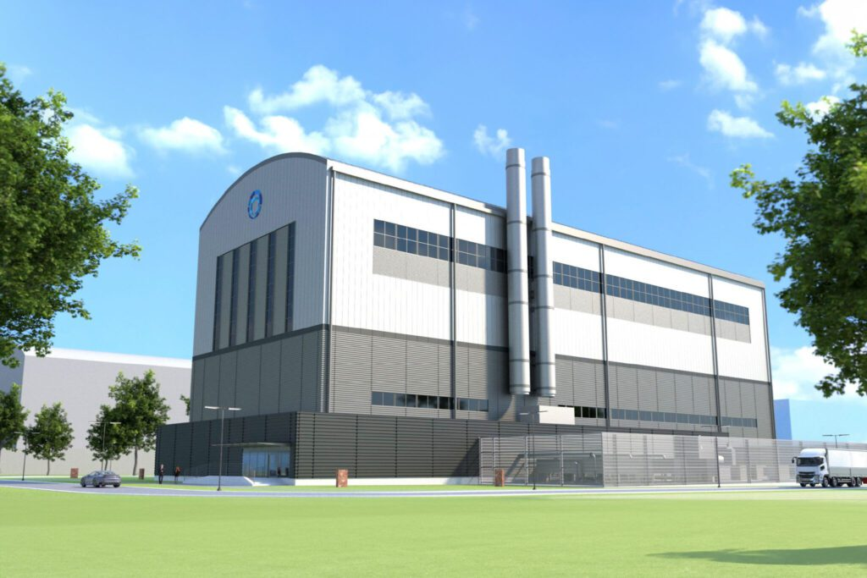
Non light-water advanced reactors leverage new reactor technologies and fuels to enter new markets
TerraPower Natrium
345 MW_{e}/ 840 MW_{th} sodium cooled reactor with thermal energy storage
Capable of ramping between 100 MW_{e} and 500 MW_{e} of electricity output
First customers will be PacifiCorp
and Microsoft
X-Energy Xe-100
80 MW_{e}/200 MW_{th} modular
high temperature gas reactor
Commercial operation for combined heat and power production
First customers will be Dow Chemical, Energy Northwest, and Amazon
Kairos Power Hermes
50 MW_{e}/ 125 MW_{th} molten salt reactor with TRISO fuel pebbles
Received construction permit for two demonstration reactors
First customers will be Tennessee Valley Authority and Google
Confidential & Not for Distribution

Slide 8
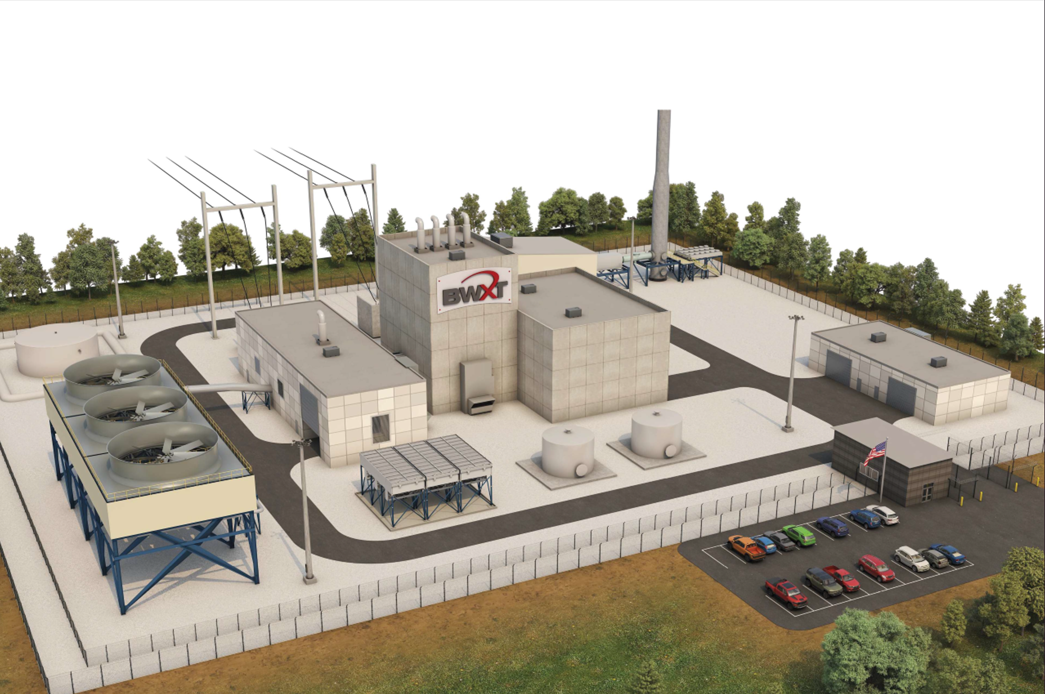
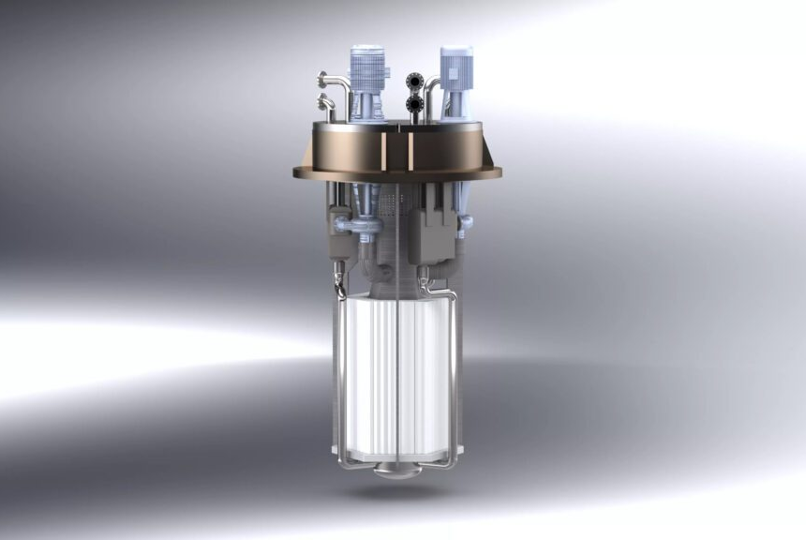
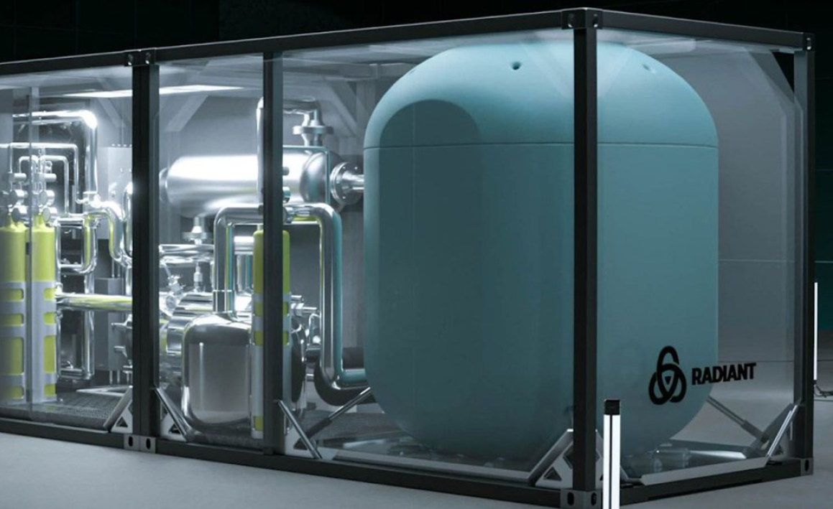
Microreactors for energy or heat production could meet the needs of individual users or microgrids
BWXT BANR
15 MW_{e}/50 MW_{th} modular
high temperature gas reactor
Builds on Project Pele transportable microreactor project for DoD
Planned initial deployment
in Texas and Wyoming by 2029
Aalo Aalo-X
10 MW_{e}/30 MW_{th} sodium
cooled fast reactor
Builds on Idaho National Lab (INL) MARVEL reactor concept
Testing planned at INL in 2026
Radiant Kaleidos
1 MW_{e}/3 MW_{th} modular
high temperature gas reactor
Highly deployable for remote power
Testing planned at INL in 2027
First customers will be U.S. Air Force
at unnamed U.S. base in 2028
Confidential & Not for Distribution

Slide 9

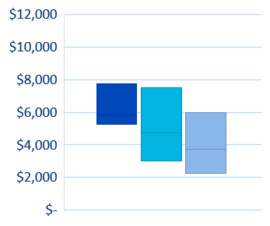
Analysis of best practices and learning by doing suggest substantial cost reductions over time for nuclear energy
Vogtle 3 & 4
$16,000
Actual
$14,000
INL cost study conclusions:
Lower initial costs for standardized large reactors with 23 – 57% cost reductions from widescale deployment
Higher initial costs for standardized SMRs with 38 – 64% cost reductions from factory manufacturing
Large Nuclear Reactors
Small Modular Reactors
Best Practices
$/kWe CapEx (2022 Dollars)
2030
2040
2050
2030
2040
2050
2022
Idaho National Lab Study on Future Advanced Reactor Costs
Confidential & Not for Distribution

Slide 10
Nuclear safety, nuclear risk, and nuclear regulation are ultimately social, political, and technical processes
Societal views on activity
hazards, harms, trade-offs,
risks, and stakeholders
Political acceptance of trade-offs,
response to stakeholders, and assessment of technical considerations
Social Considerations
Political Considerations
Scientific and engineering
evaluations of hazards, harms, trade-offs, and risks
Should regulations should consider the impacts of different comparable technologies or cost/benefits?
Technical
Considerations

