Slide 1



Westinghouse Non-Proprietary Class 3 3
© 2025 Westinghouse Electric Company LLC. All Rights Reserved.
Westinghouse
US Nuclear Landscape
June 2026
AP1000®, eVinci™ and AP300™ are trademarks or registered trademarks of Westinghouse Electric Company LLC, its affiliates and/or its subsidiaries in the United States of America and may be registered in other countries throughout the world. All rights reserved. All rights reserved. Unauthorized use is strictly prohibited. Other names may be trademarks of their respective owners.

Slide 2

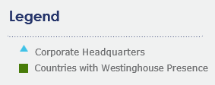
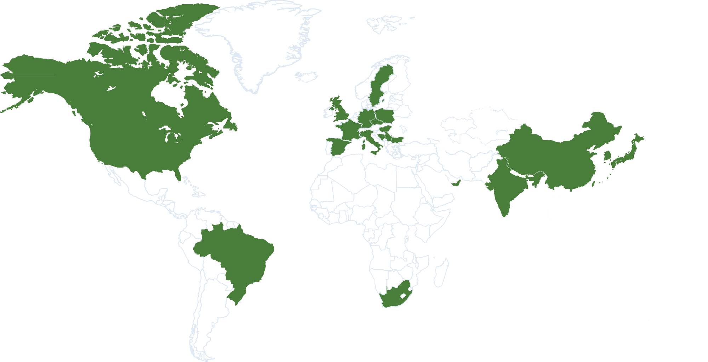
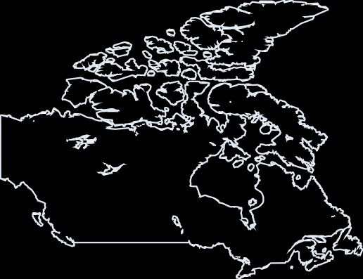
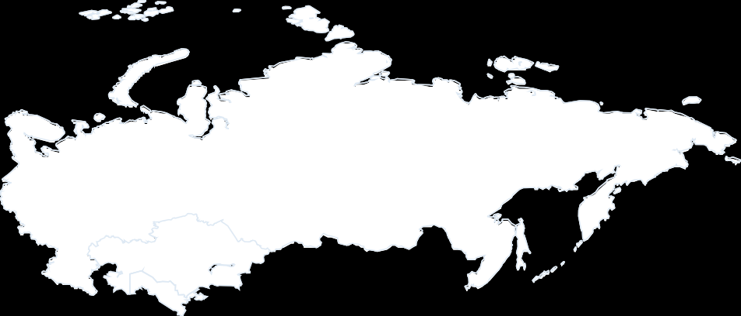








global presence
Westinghouse
Corporate Headquarters
Cranberry Twp., Pennsylvania (USA)
Westinghouse by the Numbers
More than
11,000
employees worldwide
more than
90
facilities
21
countries
3 fuel fabrication facilities
Westinghouse is the original equipment manufacturer or a technology provider to:
~50% of the global nuclear reactor fleet, delivering capacity of ~190,000 carbon-free MWe
Westinghouse Non-Proprietary Class 3 | © 2026 Westinghouse Electric Company LLC. All Rights Reserved.
Notes:
Opportunity for you to talk about 3 generations of Wybles at WEC and Nuclear Promise – how your three generations supported development of 50% of nuclear fleet

Slide 3


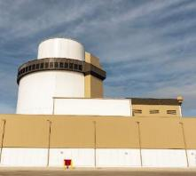
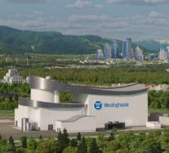
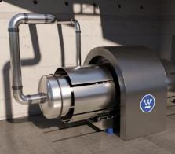
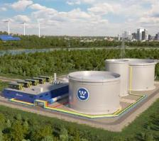
Innovative Solutions Portfolio
Meeting customers’ flexible energy demands by shaping today’s and tomorrow’s energy landscape
AP1000® PWR
1100+ MWe
AP300™ SMR
330 MWe
eVinci™ Microreactor
5 MWe
Long Duration Energy Storage
8 hours to 200 hours
Our reactors can also deliver beyond electricity benefits
Hydrogen Generation and Process Heat
Radioisotope Production
Fuel Cycle Closure and Waste Recycle/Reduction
Westinghouse Non-Proprietary Class 3
© 2025 Westinghouse Electric Company LLC. All Rights Reserved.

Slide 4
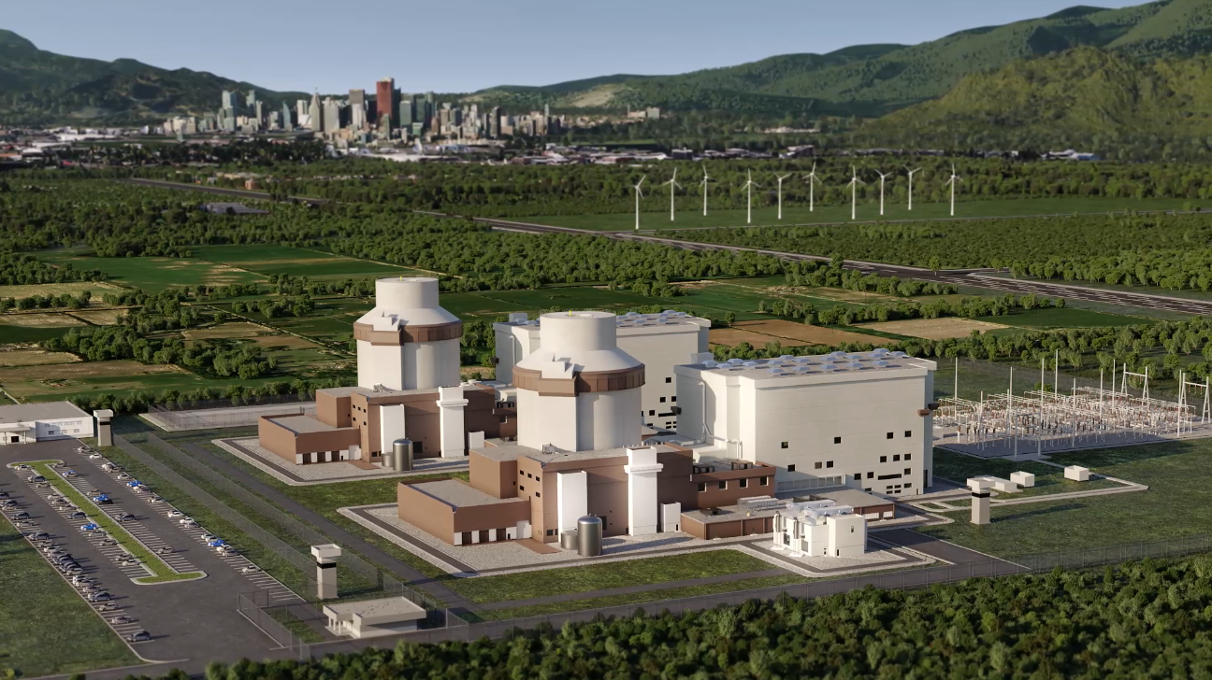

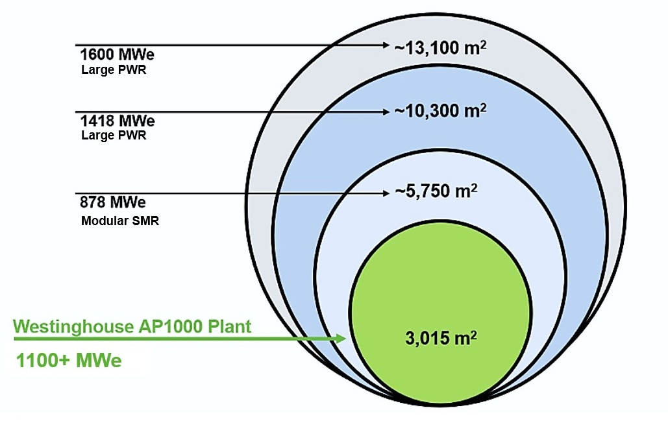






AP1000 PWR
Most Advanced, Proven Generation III+ Pressurized Water Reactor with Fully Passive Safety Systems
  Innovative
  Flexible
  Fully-passive safety systems protect the plant for over 72 hours, even in the event of a station blackout.
  Able to rapidly follow changes in demand and offers co-generation options such as district heating & desalination.
AP1000 Plant Footprint Comparison
  Proven
  Shovel Ready
  Cost effective
  Breaking performance records across the operational fleet.
  Optimized and fully digital construction, 5 year construction period
  (First Nuclear Concrete to Commercial Operation Decision).
  Simplified, modular design means lower construction, operating and maintenance costs.
Westinghouse Non-Proprietary Class 3 | © 2026 Westinghouse Electric Company LLC. All Rights Reserved.

Slide 5
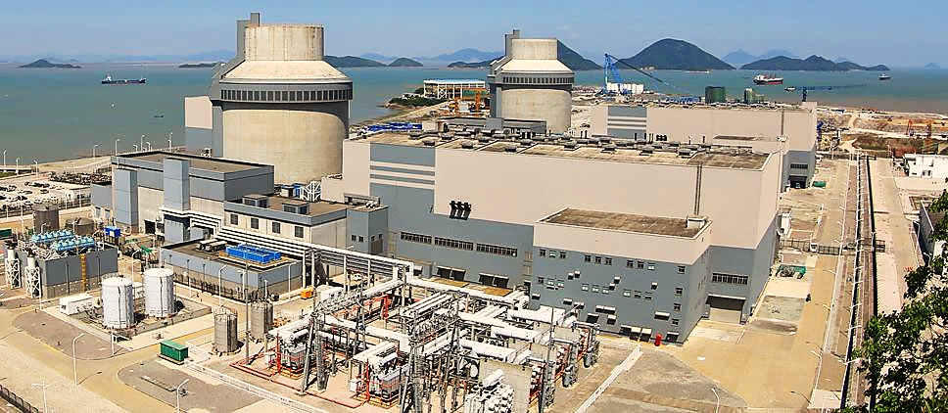



Continuous Improvement
Insights Gained Through Project Experience
  FOAK Equipment & Procurement
  Criticality of Engineering Timing
  First time Regulatory Challenges
  Construction Planning
  Lessons learned on FOAK manufacturing issues
  Higher percent of engineering design to be completed earlier
  First new plant built per new licensing process
  Utilizing Engineering Delivery Model for new plant projects
  Improve supplier selection process; prioritize quality & experience
  Earlier engineering support for procurement, fabrication & construction
  New requirements for digital testing & securing local permits
  Digital work packages for full integration of construction to design
  Greater utilization of internal engineering over subcontractors
  Overcame regulatory holds on key shipments
Westinghouse Non-Proprietary Class 3 | © 2026 Westinghouse Electric Company LLC. All Rights Reserved.

Slide 6
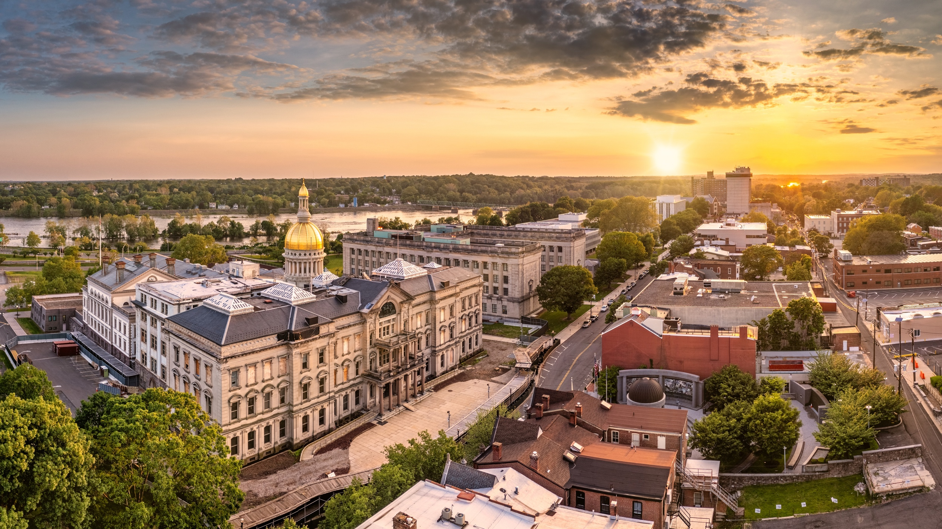
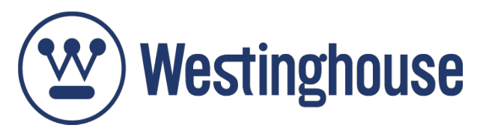
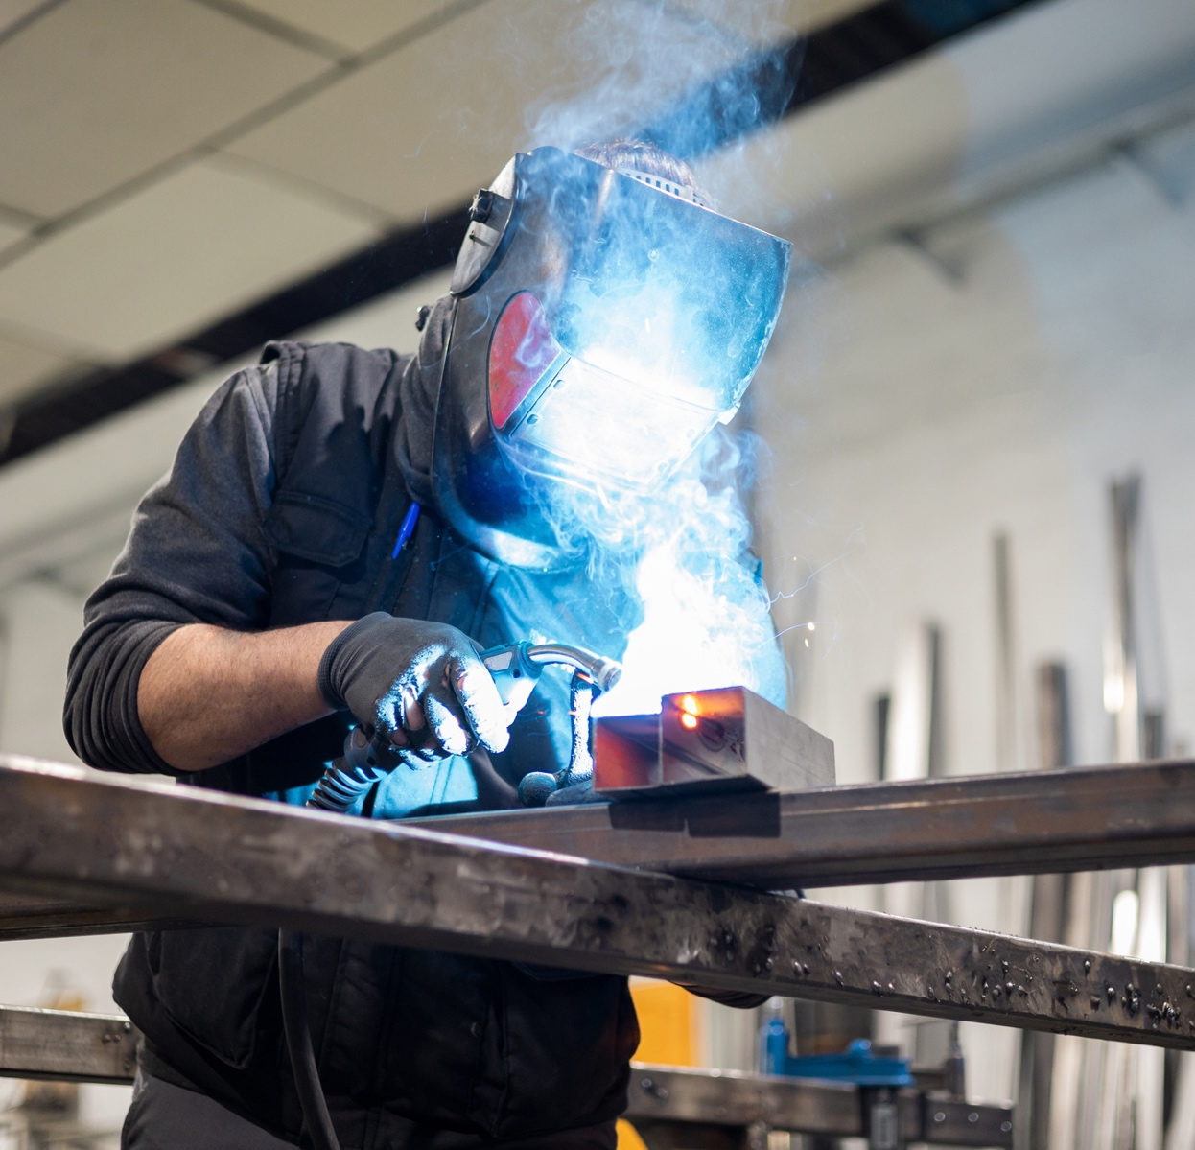
New Jersey’s
Nuclear Advantage
The Skilled Trades, Local Supply Chains,
and the Communities that Make It Possible
New Jersey Today & Tomorrow
100% carbon-free electricity by 2050
“The nuclear resurgence will come in all shapes and sizes, but it can't happen without a firm foundation of gigawatt scale Generation III+ reactors. -Craig Piercy, CEO, American Nuclear Society
www.westinghousenuclear.com/
Notes:
Photo location: Trenton, NJ

