Slide 1
How AI Can Save Education …
Nidhal Carla Bouaynaya
Associate Vice President for AI
Professor of Electrical and Computer engineering
Rowan University

Slide 2


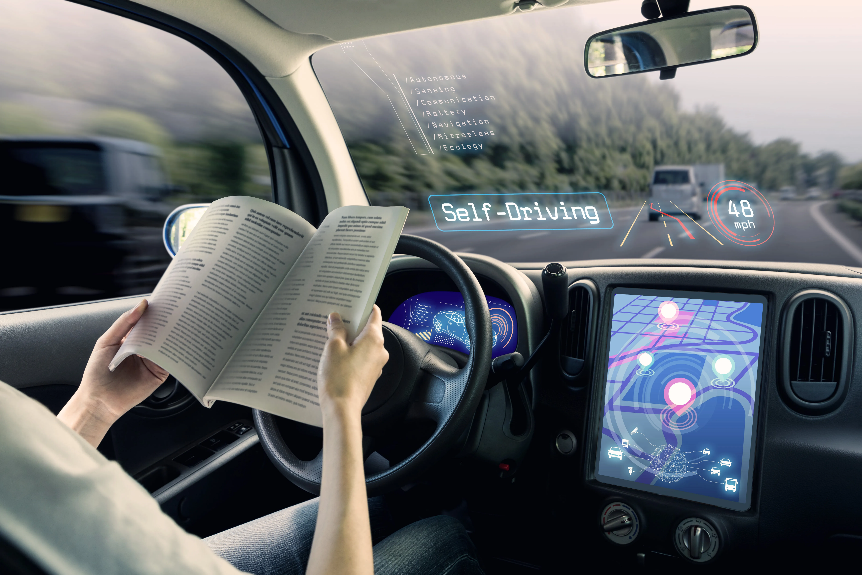
The AI Revolution across Sectors
AI is already part of our daily lives – from voice assistants to medical diagnostics – transforming how we live, educate, and work.
77% of companies are using or exploring the use of AI in their businesses.
83% of companies claim that AI is a top priority in their business plans.
85% of Fortune 500 companies use AI to shape their future.
In the next 3years, 92% of companies plan to increase their AI investments.
McKinsey research sizes the long-term AI opportunity at $4.4 trillion in added productivity growth potential from corporate use cases.
“I’ve always thought of AI as the most profound technology humanity is working on . . . more profound than fire or electricity or anything that we’ve done in the past.”
- Sundar Pichai, CEO of Google

Slide 3

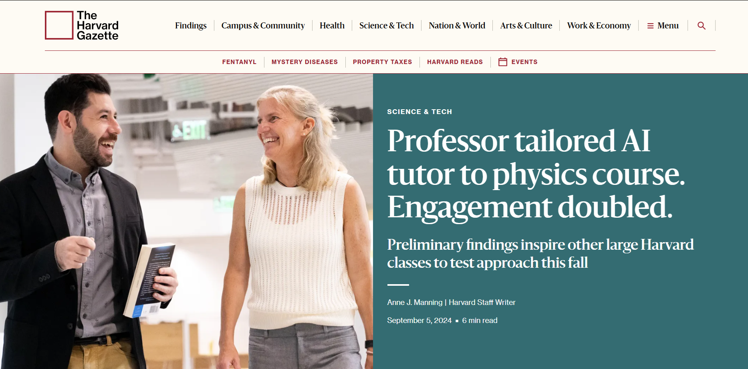
How AI is Transforming Education?
A 24h/day, 7 days/week, personalized AI Tutor for every student.
Notes:
“Can you help me understand overfitting in machine learning?”
Give me a visual explanation
https://chatgpt.com/g/g-67fd19655b108191b9678c34373b46b7-miles-for-machine-learning
In ChatGPT Education, user data, including conversations and uploaded files, is encrypted. OpenAI and third parties do not have access to this data. Additionally, data uploaded for data analysis is stored on a private server for active access but is deleted after 3 hours, with manual deletion options available.

Slide 4
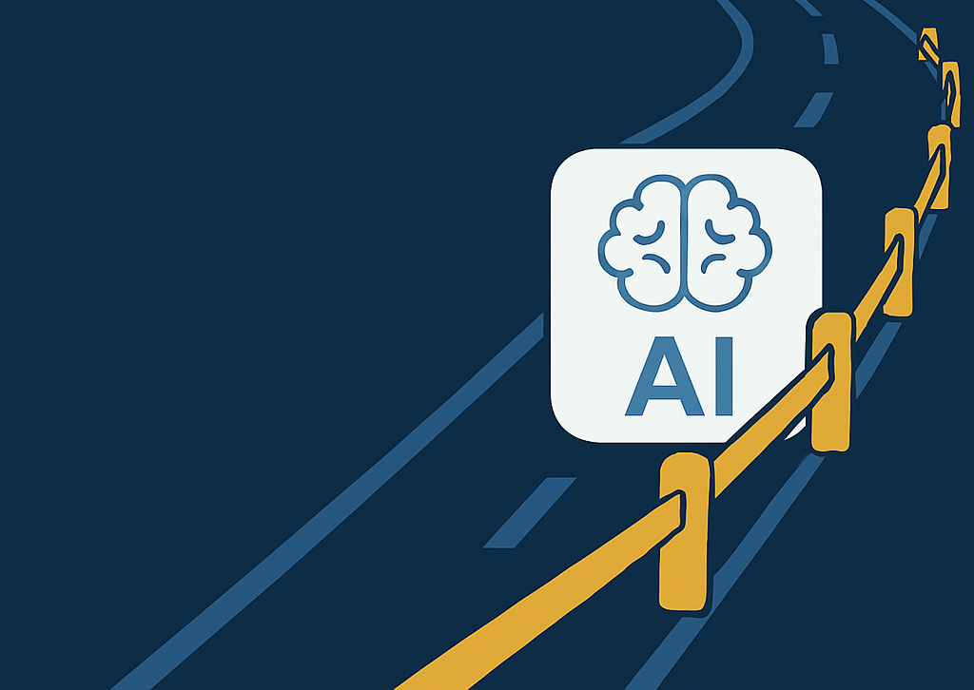
Responsible Use of AI
alongside AI’s promise, there are risks we must manage.
Bias and Fairness: AI can discriminate if trained on biased data.
  Amazon had to shut down an AI hiring tool that learned to penalize women’s resumes.
  If unchecked, AI could deny opportunities to certain groups.
Privacy Concerns: AI thrives on data, but that raises privacy issues.
  People worry: who sees my data and how is it used?
  70% of Americans have little to no trust in companies to use AI data responsibly​.
Adversarial Attacks (Robustness): Clever tricks can fool AI systems.
  Researchers put a few stickers on a stop sign and an AI misread it as a speed-limit sign​.
  Malicious actors could exploit this to cause accidents or security breaches.
Transparency (“Black Box” issue): Many AI models can’t explain their decisions.
  Opacity undermines trust.
  If a loan AI rejects an application or an autonomous car makes a split-second decision, we struggle to understand why.
Notes:
For instance, in education, we must safeguard student data and require human review of AI-generated tutoring content.
universities establishing AI ethics committees or guidelines for classroom AI use.
In business, companies set standards so that AI recommendations align with company ethics and comply with regulations

Slide 5
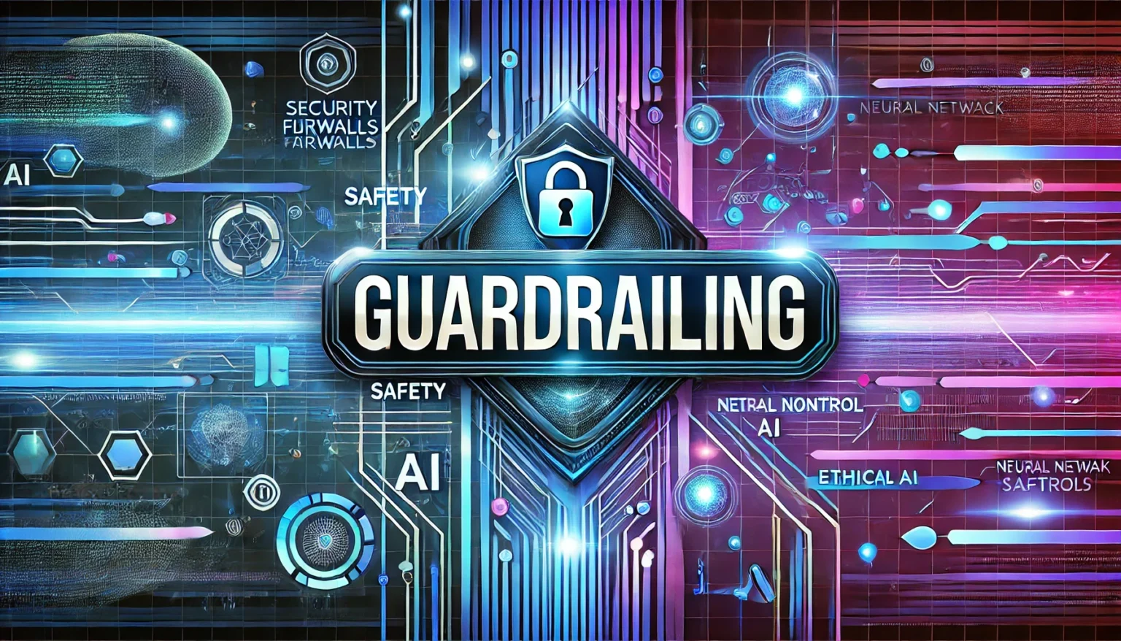
Rowan’s Strategy for Ethical & Safe AI
We recognize that “AI ethics” isn’t just a buzzword but a necessary component of AI integration.
Our approach: Implement guardrails - transparency, accountability, bias checks, and safety nets.
“AI is here to stay… We choose to embrace it, and we’re integrating AI into education, training and medical research to drive innovation and opportunity.”
- Rowan University President Ali Houshmand​

Slide 6

Pillar 1 – Education Initiatives
AI Literacy for All: Launching an “AI for Everyone” course open to all majors, inspired by Stanford’s multidisciplinary AI literacy efforts.
  Goal: ensure every Rowan student gains a basic understanding of AI and its societal impacts
Across the Curriculum: Working with faculty in non-STEM fields (arts, humanities, business), medical schools, and professional studies to embed AI topics into their courses and create new interdisciplinary programs.
  E.g., Med students learn how AI aids diagnosis; art students use AI in creative projects.
Faculty Training & Ethics: Providing workshops for faculty on using AI tools in teaching (like how to let students use GPT ethically) and incorporating AI ethics discussions into classwork so students consider both the power and pitfalls of AI.
Real-World Projects: Encouraging interdisciplinary student projects on AI (a history major and a CS major tackling an AI ethics case study, for instance) to broaden perspectives.

Slide 7
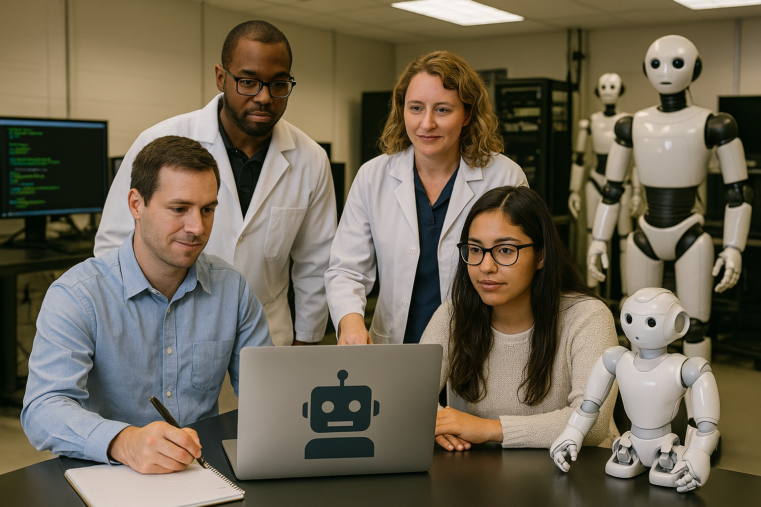

Pillar 2 – Research & Development Initiatives
Building Infrastructure: Invest in high-performance computing, data storage, and AI software platforms.
Interdisciplinary Collaboration: Foster collaboration between departments.
  E.g., our engineers and clinicians team up to develop an AI for early disease detection.
Industry & Govt Partnerships: Teaming up with external partners to solve practical problems and stay at the forefront.

Slide 8
Pillar 3 – Administration & Operations Initiatives
AI-Powered Campus: Integrate AI assistants into university life to boost productivity and service.
  Microsoft 365 Copilot for faculty and staff – an AI helper that drafts emails, summarizes reports, and accelerates tedious tasks, all with enterprise-grade data privacy​.
Smarter Student Services: Use chatbots and AI advisors to answer student questions 24/7 (from IT help to admissions info). AI can also analyze student data to alert advisors when a student may need support, improving outcomes.
Digital Transformation: Streamline operations like scheduling, facilities management, and HR with AI tools. This frees up staff time for higher-level work and makes campus operations more responsive.
Responsible Use Policies: Alongside new tools, we’re updating policies and training to ensure responsible use of AI.
  E.g., Guidelines on data use.

