Slide 1



Trailblazing with AI:
A Journey for Modern Small to Medium Business
The Steve Sweeney Center for Public Policy
Artificial Intelligence: Opportunities and Challenges for New Jersey Government, Business and Education Conference
April 15, 2025
Tim Guim, CEO

Slide 2
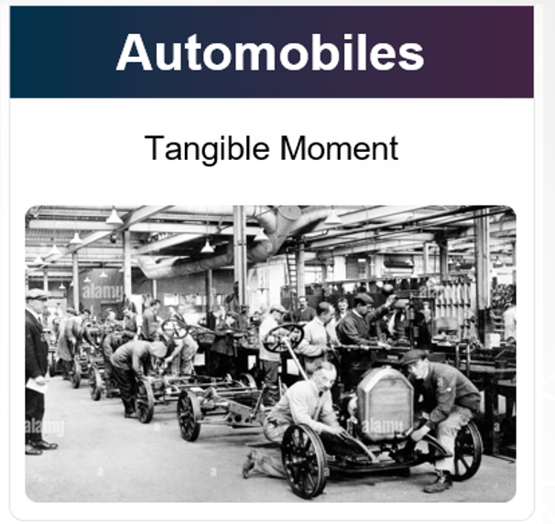

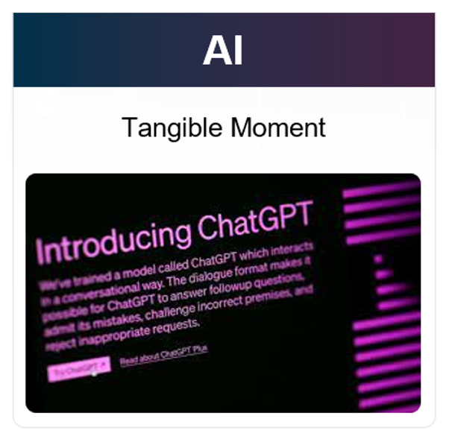

Every disruptive innovation has a tangible moment that births new markets and disrupts existing ones

Slide 3



How to think about AI
Human Only Tasks
AI as a Co-Pilot
Completely Automated AI

Slide 4
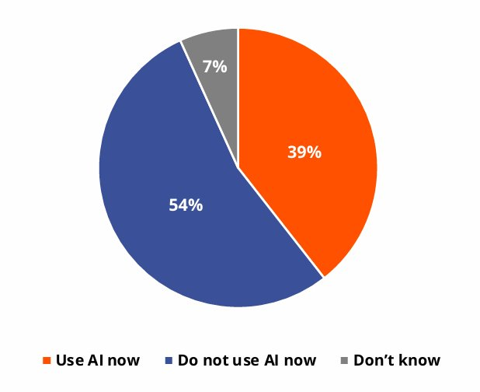
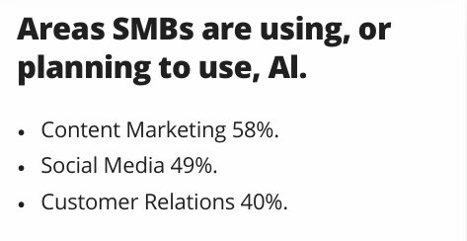
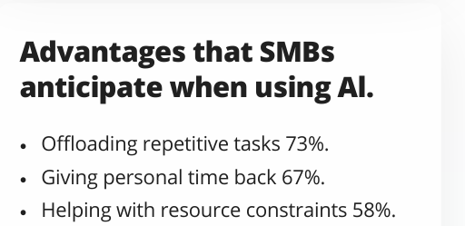
Current State of SMB AI Adoption
Q2 2024 Thryv Report
Notes:
Handout
Give expample

Slide 5
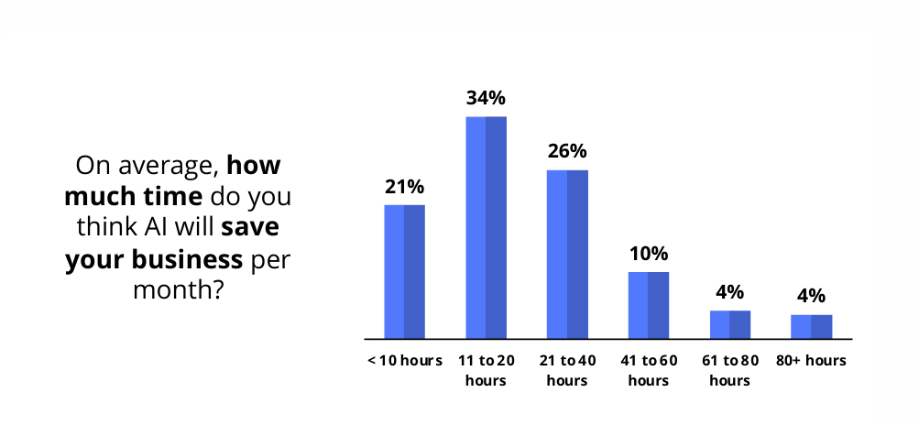
Projected Time Savings
Q2 2024 Thryv Report
Notes:
Handout
Give expample

Slide 6
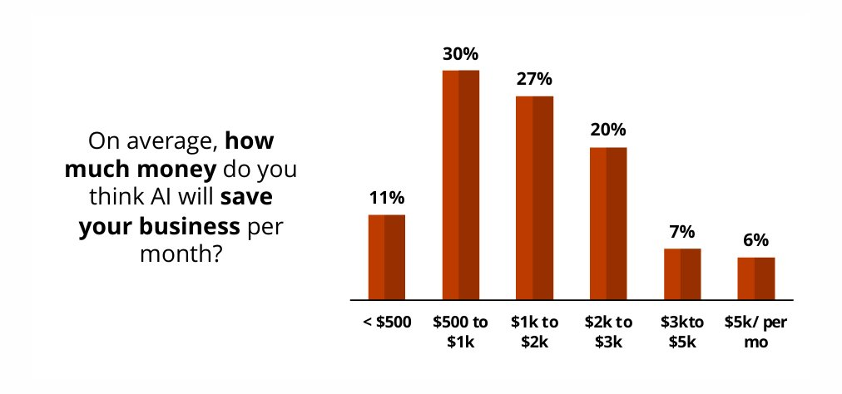
Projected Cost Savings
Q2 2024 Thryv Report
Notes:
Handout
Give expample

Slide 7
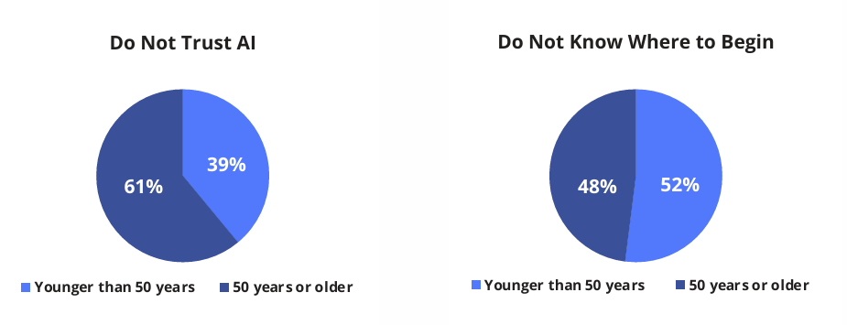
Reasons Given Not to Adopt AI
Q2 2024 Thryv Report
Notes:
Handout
Give expample

Slide 8
AI Journey for the Small to Midsize Business
Crawl -> Walk -> Run

Slide 9
SMB AI ADOPTION IS TOP DOWN AND BOTTOM UP
GOVERNANCE AND
COMPLIANCE
C-SUITE
IT AND SECURITY
AI STRATEGY
ACCEPTABLE USE
EMPLOYEE TRAINING
APPROVED TOOLS
FREE FOR ALL WITH TOOLS USED
LOW HANGING FRUIT USE CASES
MEASUREABLE EFFICIENCY GAINS
INTERNAL AI ADVOCATES
TECH SAVVY WORKERS
GEN Z
AI EXPLORERS
Notes:
Next Steps for Implementing AI in Your Organization:
1. Develop an AI Policy:
- Create a comprehensive AI policy tailored to your organization's needs. This policy should outline the goals, ethical considerations, and governance structures related to AI use within your organization.
- Regularly review the NIST AI Risk Management Framework to ensure your policy aligns with best practices and current standards.
2. Select and Approve Secure AI Tools:
- Identify AI tools that meet your organization’s specific requirements, with a strong emphasis on security and data privacy.
- Conduct a thorough evaluation and obtain necessary approvals to ensure these tools adhere to both your internal security protocols and industry standards.
3. Implement AI Training Programs:
- Develop and roll out training programs to educate your team on AI technologies, focusing on their application, benefits, and potential risks.
- Ensure training covers ethical use, compliance with the NIST AI framework, and how to effectively leverage AI tools in day-to-day operations.

Slide 10
AI Acceptable Use Policy
User Roles and Responsibilities
Approved Secure AI Tools
Protection Confidential Data
Protection of Intellectual Property
Ethical Use
AI in Generation of Copyrightable Content
Penalty of Breach of Policy

Slide 11

Shake the Tree
Find your AI Explorers
Look for use cases that are low hanging fruit
Measure ROI:
    Time savings
    Financial Impact
    Customer service Improvements

Slide 12
Closing Thoughts
Start Now
Adopt an AI Acceptable Use Policy
Put Secure AI Tools in Place
Commit to use AI 30 minutes per day
Shake the Tree
Rinse and Repeat

Slide 13

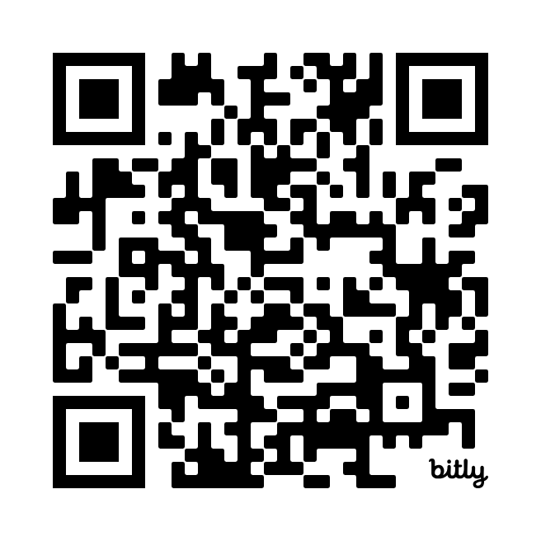

Questions – Let Connect
Tim Guim, CEO
PCH Technologies

